Slide 1
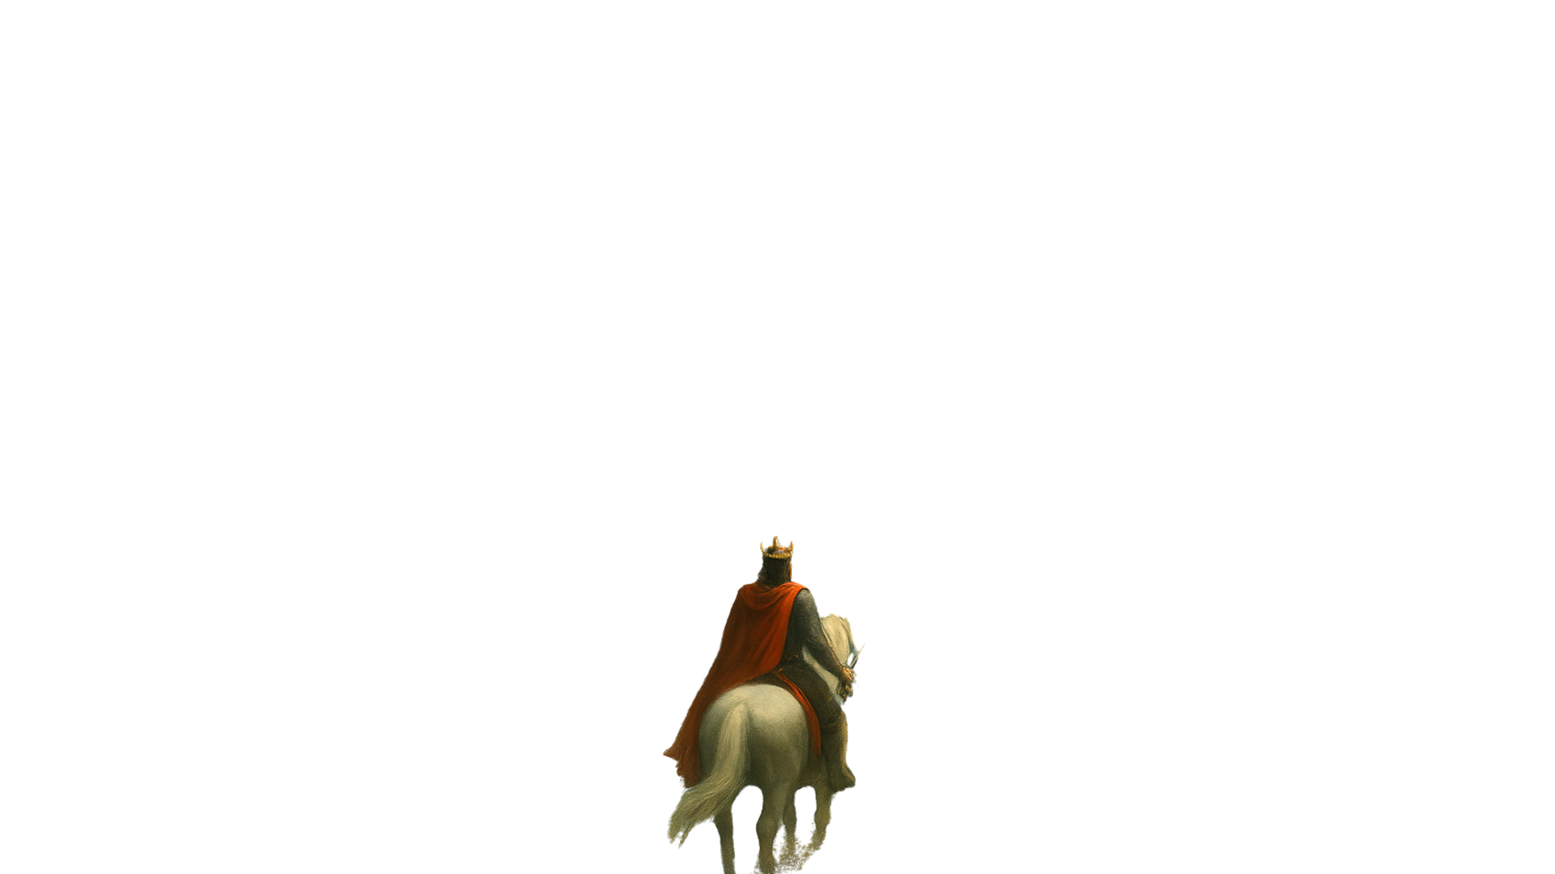

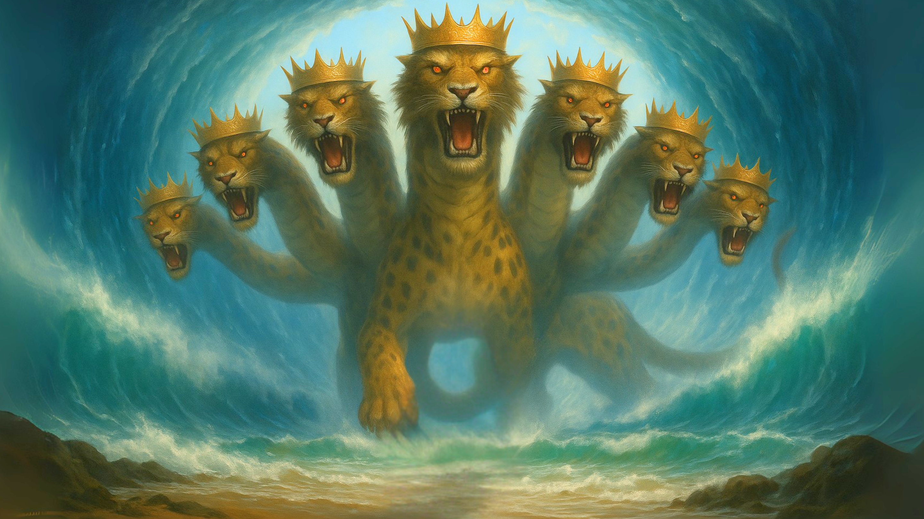

Slide 3
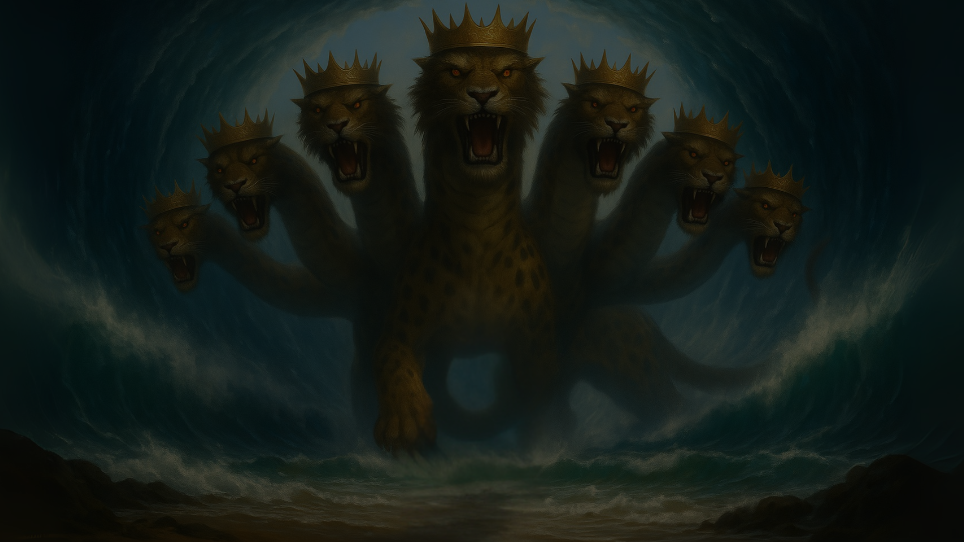
Evidence for The Early Date of Revelation

Slide 4
Early Date Evidences
External Historical Evidence
  No Early Christian Writers state the 60s
  Epiphanius of Salamis (315-403)

Slide 5
EXTERNAL EVIDENCE
Clement of Alexandra (Late 2nd Century)
“For the Apostle John, who lived in Asia, after he was exiled to the island of Patmos, wrote the Apocalypse and afterward returned to Ephesus, where he remained until his death.”
— Clement of Alexandria, as cited in Eusebius, Ecclesiastical History 3.23.6

Slide 6
EXTERNAL EVIDENCE
Irenaeus (AD180)
“for if it were necessary that his name should be distinctly revealed in this present time, it would have been announced by him who beheld the apocalyptic vision. For it was seen not very long time since, but almost in our day, towards the end of Domitian’s reign.”
-Irenaeus, Against Heresies 5.30.3

Slide 7
EXTERNAL EVIDENCE
Irenaeus (AD180)
“for if it were necessary that his name should be distinctly revealed in this present time, it would have been announced by him who beheld the apocalyptic vision. For [he] was seen not very long time since, but almost in our day, towards the end of Domitian’s reign.”
-Irenaeus, Against Heresies 5.30.3

Slide 8
EXTERNAL EVIDENCE
Irenaeus (AD180)
“for if it were necessary that his name should be distinctly revealed in this present time, it would have been announced by him who beheld the apocalyptic vision. For it was seen not very long time since, but almost in our day, towards the end of Domitian’s reign.”
-Irenaeus, Against Heresies 5.30.3

Slide 9
Early Date Evidences
External Historical Evidence
The Jerusalem argument
Nero is explicitly mentioned twice
  666 – The Mark of the Beast (Rev 13)
  “This calls for wisdom: let the one who has understanding calculate the number of the beast, for it is the number of a man, and his number is 666.”
  Revelation 13:18

Slide 10
Early Date Evidences
External Historical Evidence
The Jerusalem argument
Nero is explicitly mentioned twice
  666 – The Mark of the Beast (Rev 13)
    Gematria
      Aleph = 1, Bet = 2, Gimel = 3…
      Yod = 10, Kaf = 20, Lamed = 30…
      Qof = 100, Resh = 200, Shin = 300…
      A = 1, B = 2, C = 3…
      J = 10, K = 20, L = 30…
      S = 100, T = 200, U = 300…

Slide 11
Nero Identified
The Number of The Beast 666
  Caesar Nero → Νέρων Καῖσαρ (Nerōn Kaisar)
  נ + ר + ו + ן (Nun + Resh + Vav + Final Nun)
  ק + י + ס + ר (Qof + Yod + Samekh + Resh)
  נרון קיסר (Prounoucned Nron Qisr) = 676
    200 + 60 + 10 + 100 + 50 + 6 + 200 + 50 = 676
    Drop the unneeded Yod (י) (value 10)
  נרון קסר (Prounoucned Nron Qsr) = 666

Slide 12
Issues with the 666 Identification
It doesn’t date the book
It requires three languages to decode
Transliteration is not an exact science
  Example
    Arabic الله
    Translation → God
    Transliteration → Allah

Slide 13
Issues with the 666 Identification
It doesn’t date the book
It requires three languages to decode
Transliteration is not an exact science
  Multiple acceptable spellings
  Letters may be added or dropped
  Vowel sounds are often inferred, therefore are optional
Arbitrary Adjustments are made
  Adding Final Nun ן)) to “Nero”
  Dropping Yodי) ) Nron Qisr → Nron Qsr

Slide 14
Nero Identified
The Number of The Beast 666
  Caesar Nero → Νέρων Καῖσαρ (Nerōn Kaisar)
  נ + ר + ו + ן (Nun + Resh + Vav + Final Nun)
  ק + י + ס + ר (Qof + Yod + Samekh + Resh)
  נרון קיסר (Prounoucned Nron Qisr) = 676
    200 + 60 + 10 + 100 + 50 + 6 + 200 + 50 = 676
    Drop the unneeded Yod (י) (value 10)
  נרון קסר (Prounoucned Nron Qsr) = 666

Slide 15
Cody Layne Chesser is the Beast of Revelation
The Number of The Beast 666
  Cody Layne Chesser → Κόντι Λέιν Τσέσερ
  כודיליצ׳סר (20+6+4+10+30+10+90+60+200 = 430)
    Change צ׳ into the commonly substituted כ ו ש (maintain the “ch” sound in Chesser)
  כודיליכושסר
  20+6+4+10+30+10+20+6+300+60+200 = 666

Slide 16
Other Possible Names for the Beast
Steven Charles Estes
  סטוון שכלסיא אסטס
Spongebob Squarepants
  ספוגבבסקורפנס
Tom Riddle (aka. Lord Voldemort)
  תום רידו (aka. לורד וולדהלמורטצ)
Inscription of Late first century Roman Coins: Α ΚΑΙ ΔΟΜΕΤ ΣΕΒ ΓΕ
Emperor Caesar Domitian The “Honored One” [year]

Slide 17
Early Date Evidences
External Historical Evidence
The Jerusalem argument
Nero is explicitly mentioned twice.
  666 – The Mark of the Beast (Rev 13)
    Gematria
  The Five Fallen Kings” Prophecy (Rev 17)

Slide 18
This calls for a mind with wisdom: the seven heads are seven mountains on which the woman is seated;
they are also seven kings, five of whom have fallen, one is, the other has not yet come, and when he does come he must remain only a little while.
As for the beast that was and is not, it is an eighth but it belongs to the seven, and it goes to destruction
Revelation 17:9-11
Roman Emperors
1.Julius Caesar
2.Augustus
3.Tiberius
4.Caligula
5.Claudius
6.NERO

Slide 19
This calls for a mind with wisdom: the seven heads are seven mountains on which the woman is seated;
they are also seven kings, five of whom have fallen, one is, the other has not yet come, and when he does come he must remain only a little while.
As for the beast that was and is not, it is an eighth but it belongs to the seven, and it goes to destruction
Revelation 17:9-11
Roman Emperors
Julius Caesar
2.Augustus
3.Tiberius
4.Caligula
5.Claudius
6.NERO

Slide 20
This calls for a mind with wisdom: the seven heads are seven mountains on which the woman is seated;
they are also seven kings, five of whom have fallen, one is, the other has not yet come, and when he does come he must remain only a little while.
As for the beast that was and is not, it is an eighth but it belongs to the seven, and it goes to destruction
Revelation 17:9-11
Roman Emperors
Julius Caesar
1.Augustus
2.Tiberius
3.Caligula
4.Claudius
5.NERO
6.Galba

Slide 21
This calls for a mind with wisdom: the seven heads are seven mountains on which the woman is seated;
they are also seven kings, five of whom have fallen, one is, the other has not yet come, and when he does come he must remain only a little while.
As for the beast that was and is not, it is an eighth but it belongs to the seven, and it goes to destruction
Revelation 17:9-11
Roman Emperors
1.Julius Caesar
2.Augustus
3.Tiberius
4.Caligula
5.Claudius
6.NERO

Slide 22
Early Date Evidences
External Historical Evidence
The Jerusalem argument
Nero is explicitly mentioned twice.
  666 – The Mark of the Beast (Rev 13)
    Gematria
  The Five Fallen Kings” Prophecy (Rev 17)

