Slide 1




Slide 3

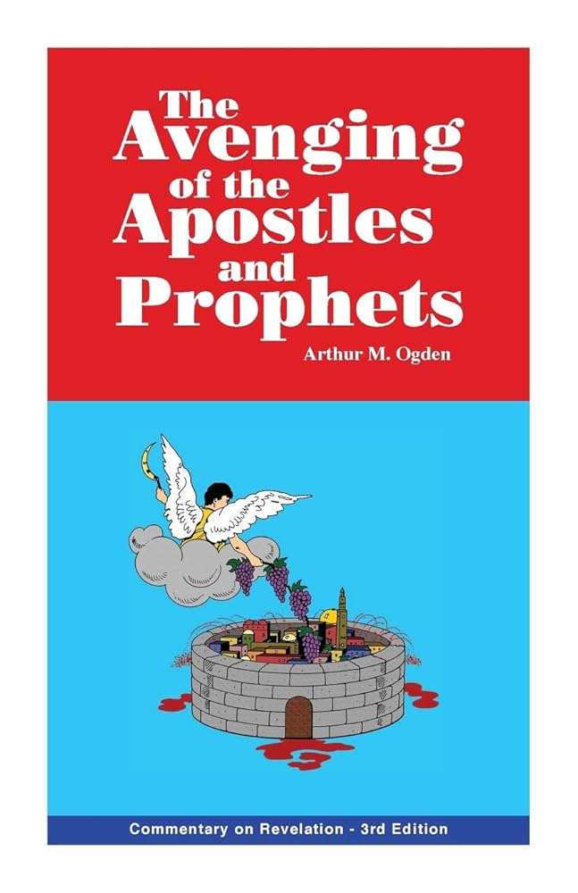

Slide 4
“To my knowledge, for the most part, the arguments advanced in this presentation are not found in any other printed work…This material is so different it will require the total cleansing of the mind of all misconceptions of the apocalypse in order to accept it. This is the unique feature of the book…Enlightenment will be your reward.”
Ogden pg-xii (preface)

Slide 5
Ogden’s Position
Historical and Preterist
“Revelation has little, if any, meaning for Christians today.” (Ogden, pg-6)
“The message is still as fresh and meaningful to us today.” (Ogden, pg-6)

Slide 6
The Overall Approach Problems
False Conclusions
False Assertions

Slide 7
The Overall Approach Problems
False Conclusions
  “Obviously if the early date can be established, it would be unreasonable to pass over the monumental events of AD 70.” (Ogden, pg-8)

Slide 8
The Overall Approach Problems
False Assertions
  “All who dwell on the earth will worship [the sea beast]…everyone whose name has not been written in the book of life.” Revelation 13:8
  “Because there was no world-wide emperor worship, this verse must be referring to events after the rest of Revelation (Ogden, pg-10)

Slide 9
The Overall Approach Problems
False Assertions
  “All who dwell on the earth will worship [the sea beast]…everyone whose name has not been written in the book of life.” Revelation 13:8
  “Because there was no world-wide emperor worship, this verse must be referring to events after the rest of Revelation (Ogden, pg-10)

Slide 10
Evidence for Widespread Emperor Worship under Domitian
Cassius Dio – Roman History (c. AD 155–235)
Suetonius – The Twelve Caesars (c. AD 69–122)
Pliny the Younger – Letters (c. AD 61–113)
Melito of Sardis – Apology to Marcus Aurelius (c. AD 170)
Tertullian – Apologeticus (c. AD 160–225)
Eusebius of Caesarea – Ecclesiastical History (c. AD 260–340)
  Includes references to:
    Hegesippus (2nd century)
    Melito of Sardis
    Dionysius of Corinth
Lactantius – On the Deaths of the Persecutors (c. AD 250–325)
Orosius – Seven Books of History Against the Pagans (c. AD 375–418)
Foxe’s Book of Martyrs – The Second Persecution, Under Domitian, A.D. 81 (Published 1563)
  Draws from:
    Eusebius
    Tertullian
    Suetonius
    Jerome
    Various church tradition sources
Irenaeus of Lyons - Against Heresies (c. AD 180)
Bruttius - Referenced by Eusebius
Clement of Rome - First Epistle to the Corinthians (c. AD 96)

Slide 11
The Overall Approach Problems
False Assertions
  “All who dwell on the earth will worship [the sea beast]…everyone whose name has not been written in th book of life.” Revelation 13:8
  “Because there was no world-wide emperor worship, this verse must be referring to events after the rest of Revelation (Ogden, pg-10)

Slide 12
Ogden’s Dating of the Book
Internal Evidence
  “The Seven Kings” – Revelation 17
  666 & Gematria
  “The Temple” – Revelation 11
  Equating ”The Great Tribulation” In Matthew 24 with Revelation

Slide 13
Ogden’s Dating of the Book
External Evidence (Ogden, pg 16)
  “The Syriac Version of the New Testament, which is the oldest direct version of the New Testament, dating all the way back to the second century, places the Revelation in the period of Nero, 68 A.D.”

Slide 14
Ogden’s Dating of the Book
External Evidence (Ogden, pg 16)
  “The Syriac Version of the New Testament, which is the oldest direct version of the New Testament, dating all the way back to the second century, places the Revelation in the period of Nero, 68 A.D. While this evidence does not prove that John wrote the book in 68 AD, it does indicate that early church fathers accepted an early date….”

Slide 15
Ogden’s Dating of the Book
External Evidence (Ogden, pg 16)
  “The Syriac Version of the New Testament, which is the oldest direct version of the New Testament, dating all the way back to the second century, places the Revelation in the period of Nero, 68 A.D. While this evidence does not prove that John wrote the book in 68 AD, it does indicate that early church fathers accepted an early date…Other evidences could be given to support the early date of the book, but these are sufficient.”
“The case for the date of the book would be settled quickly if it were based upon the number of scholars supporting a given date.” (Ogden, pg-10)

Slide 16
Ogden’s Dating of the Book
Dismissing Irenaeus’ Statement
“for if it were necessary that his name should be distinctly revealed in this present time, it would have been announced by him who beheld the apocalyptic vision.
For it was seen not very long time since, but almost in our day, towards the end of Domitian’s reign.”
-Irenaeus, Against Heresies 5.30.3

Slide 17
Ogden’s Dating of the Book
Dismissing Irenaeus’ Statement
“for if it were necessary that his name should be distinctly revealed in this present time, it would have been announced by him who beheld the apocalyptic vision.
For it was seen not very long time since, but almost in our day, towards the end of Domitian’s reign.”
-Irenaeus, Against Heresies 5.30.3

Slide 18
Ogden’s Dating of the Book
Misrepresenting Eusebius (Ogden, pg 12)
“It is said that in this persecution under Domitian the apostle and evangelist John, who was still alive, was condemned to dwell on the island of Patmos in consequence of his testimony to the divine word.”
-Eusebius, Ecclesiastical History 3.18
“But I cannot readily admit that he was the apostle, the son of Zebedee, the brother of James, by whom the Gospel of John and the Catholic Epistle were written….For the evangelist nowhere gives his name, or proclaims himself, either in the Gospel or Epistle."
-Eusebius, Ecclesiastical History 7.25

Slide 19
Ogden’s Dating of the Book
Misrepresenting Eusebius (Ogden, pg 12)
“But I cannot readily admit that he was the apostle, the son of Zebedee, the brother of James, by whom the Gospel of John and the Catholic Epistle were written….For the evangelist nowhere gives his name, or proclaims himself, either in the Gospel or Epistle."
-Eusebius, Ecclesiastical History 7.25
“It is impossible for us to present irrefutable evidence that the apostle John wrote the book…But, since the apostle John is not identified in any of these works as author, we cannot be absolutely sure.”
-Arthur Ogden, pg 7
“A question concerning the reliability of the statement as well as its force as evidence must be raised” (Ogden, pg 12)

Slide 20
Ogden’s Dating of the Book
“A Stupid Mistake” (Ogden, pg 12)
  Δομετιανοῦ (Domitianou, possesive “of Domitian”)
  Δομετιανικός (Domitianikos, adjective “Domitianic”)

Slide 21
Ogden’s Dating of the Book
“A Stupid Mistake” (Ogden, pg 12)
  Δομετιανοῦ (Domitianou, possesive “of Domitian”)
  Δομετιανικός (Domitianikos, adjective “Domitianic”)
  Δομετιανοῦ (Domitianou, possesive “of Nero”)
  Δομετιανικός (Domitianikos, adjective “Nero”)

Slide 22
Ogden’s Dating of the Book
Dismissing Irenaeus’ Statement
“for if it were necessary that his name should be distinctly revealed in this present time, it would have been announced by him who beheld the apocalyptic vision.
For it was seen not very long time since, but almost in our day, towards the end of Domitian’s reign.”
-Irenaeus, Against Heresies 5.30.3

Slide 23
Ogden’s Dating of the Book
Dismissing Irenaeus’ Statement
“for if it were necessary that his name should be distinctly revealed in this present time, it would have been announced by him who beheld the apocalyptic vision.
For John was seen [by Polycarp] not very long time since, but almost in our day, towards the end of Domitian’s reign.”
-Irenaeus, Against Heresies 5.30.3

Slide 24
Ogden’s Dating of the Book
Dismissing Irenaeus’ Statement
“for if it were necessary that his name should be distinctly revealed in this present time, it would have been announced by him who beheld the apocalyptic vision.
For John was seen [by Polycarp] not very long time since, but almost in our day, towards the end of Nero’s reign.”
-Irenaeus, Against Heresies 5.30.3

Slide 25
The Jewish Scope
The Cry of the Martyrs (Ogden, Page 20)
“How long…until you judge and avenge our blood on those who dwell on the earth?” Revelation 6:10

Slide 26
The Jewish Scope
The Cry of the Martyrs (Ogden, Page 20)
The Scope of Vengeance (Ogden, Page 20)
Babylon is condemned for the “blood of prophets and saints and all who have been slain on the earth.” Revelation 18:24

Slide 27
The Jewish Scope
The Cry of the Martyrs (Ogden, Page 20)
The Scope of Vengeance (Ogden, Page 20)
Misplaced Emphasis on the Jews

Slide 28
Ogden’s Proposed Theme
“The victory of Christ and the church over Satan and his helpers, the victory of the saints over all foes, victory in Jesus, the heavens still reign.” (Ogden, pg-24)
“The avenging of the apostles and the prophets.” (Ogden pg-24)

Slide 29
Ogden’s Proposed Emphasis on Jerusalem
“things which must shortly come to pass” Revelation 1:1
The fulfillment of the Old Law at Jerusalem’s destruction.
PRETERISM

Slide 30
Full of inaccuracies, inconsistencies, and FALSE DOCTRINE

