Slide 1


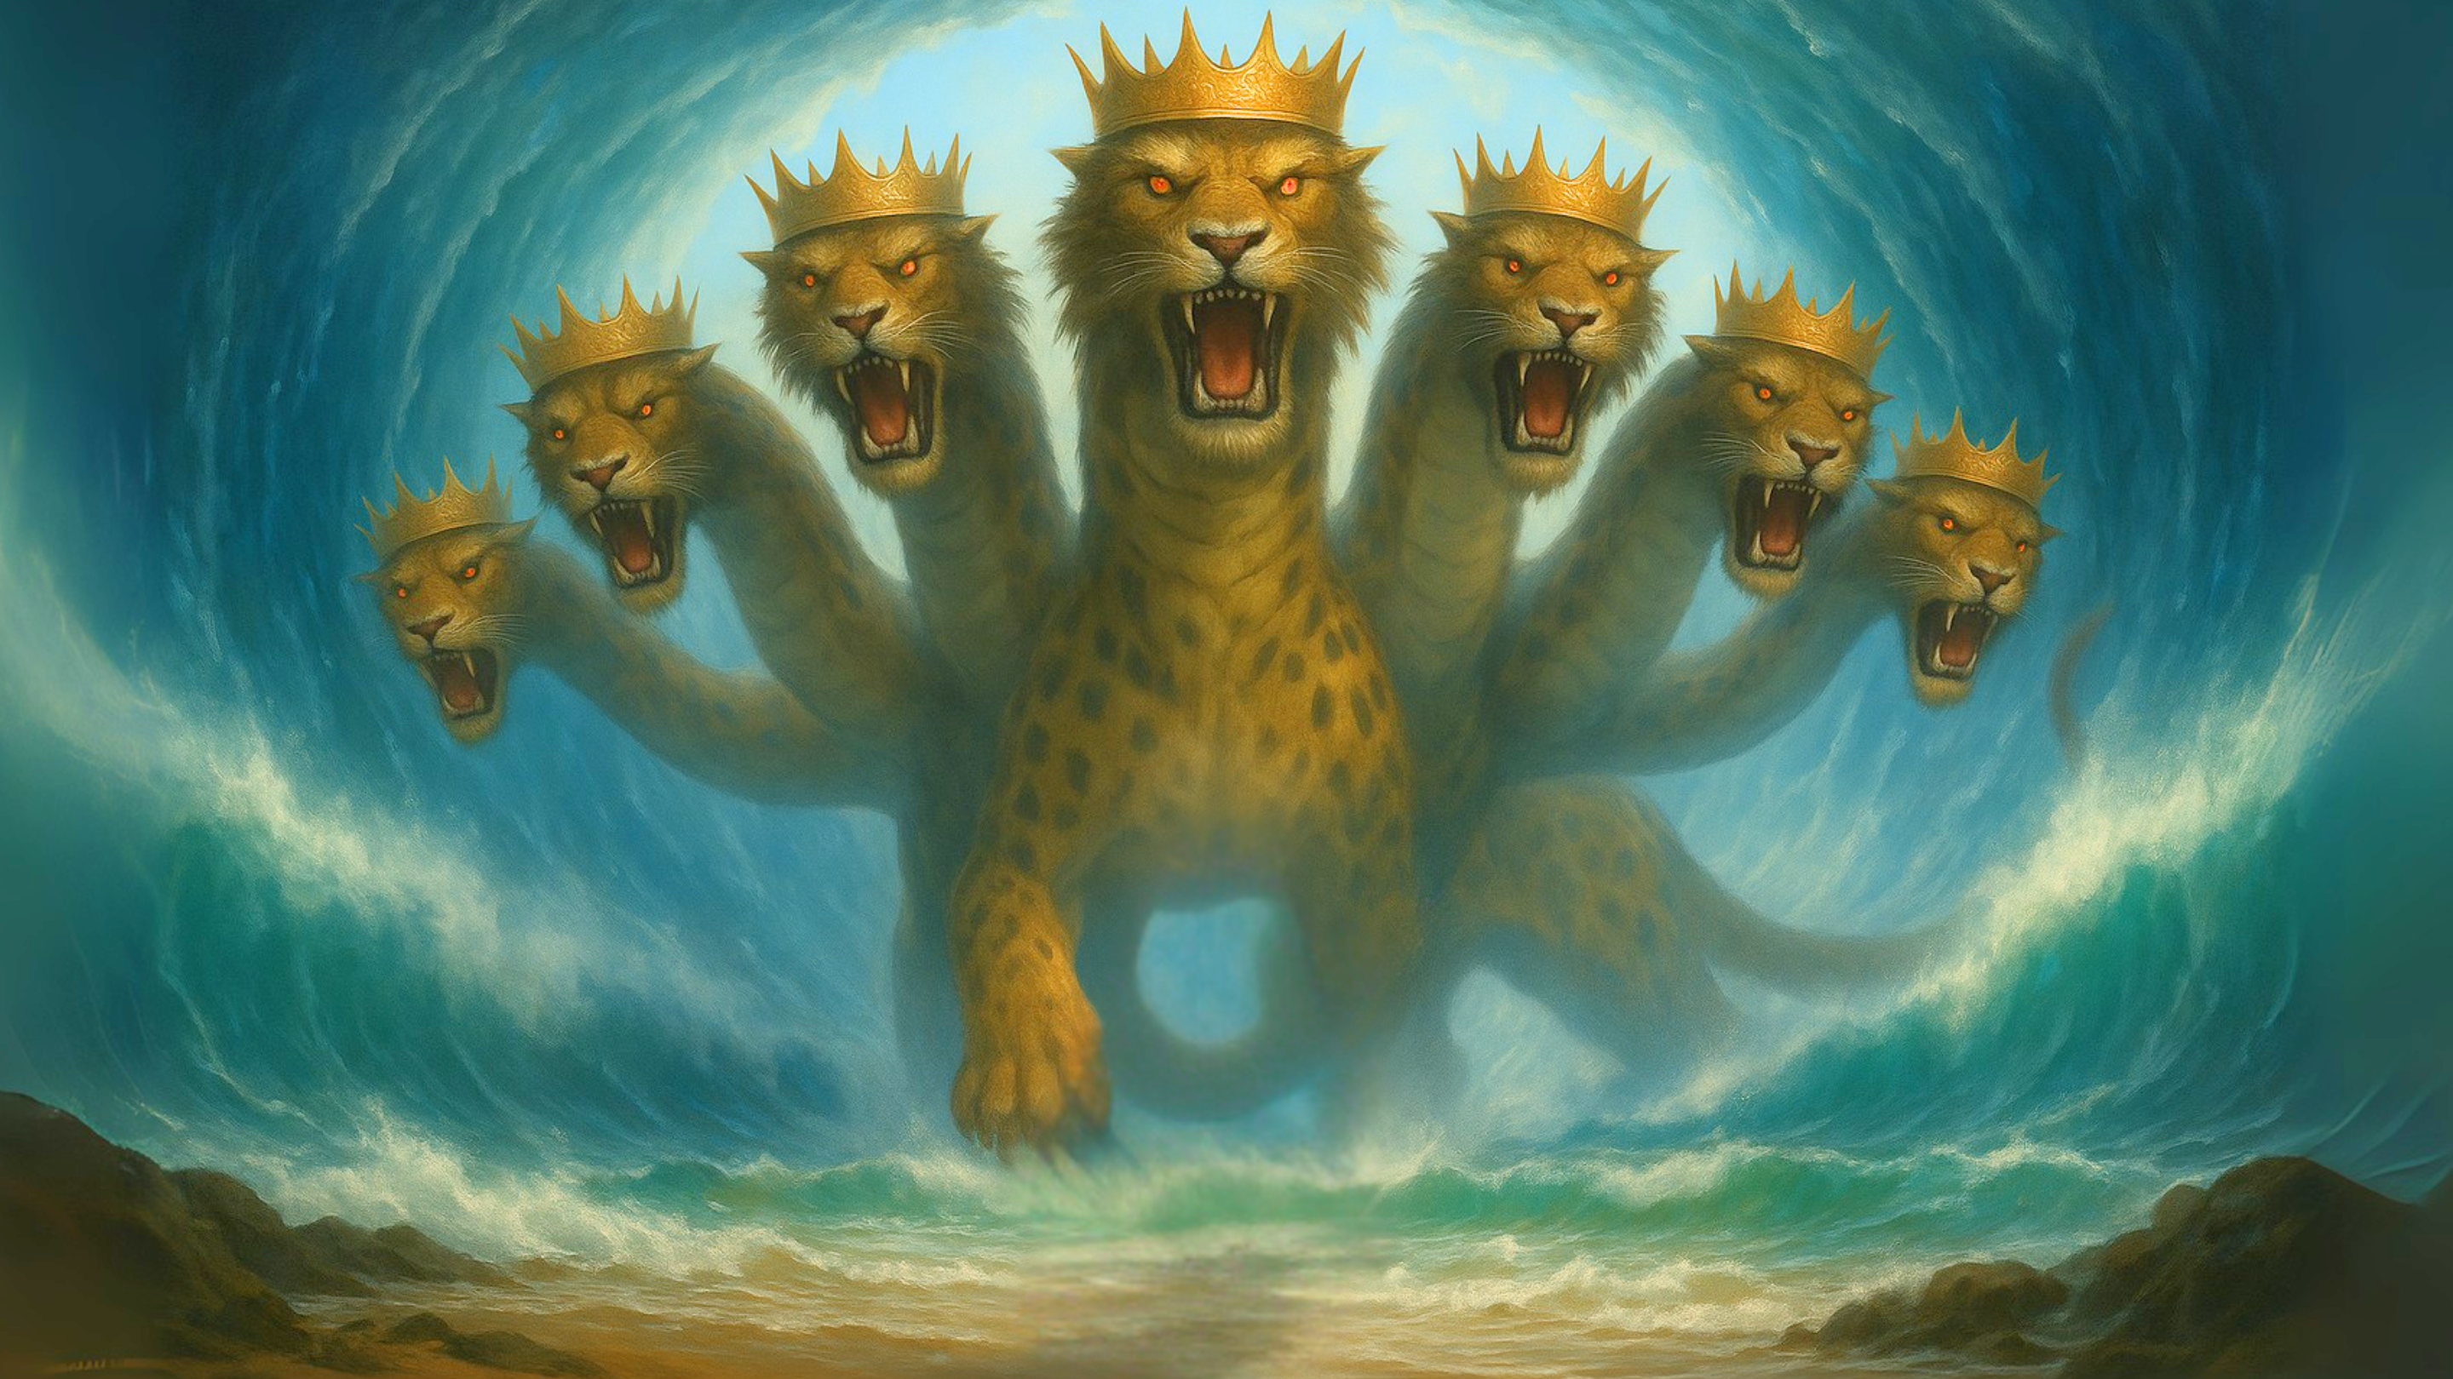

Slide 3
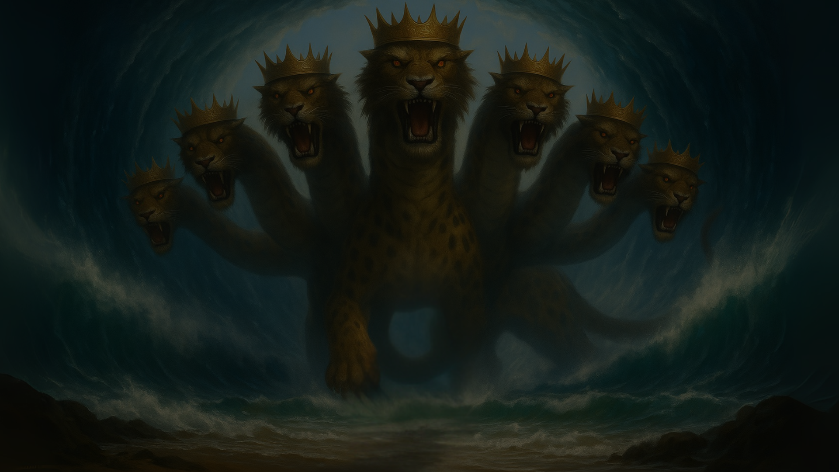
The Case for The Late
Date of Revelation

Slide 4
EXTERNAL EVIDENCE
Irenaeus (AD180)
“for if it were necessary that his name should be distinctly revealed in this present time, it would have been announced by him who beheld the apocalyptic vision.
For it was seen not very long time since, but almost in our day, towards the end of Domitian’s reign.”
-Irenaeus, Against Heresies 5.30.3

Slide 5
EXTERNAL EVIDENCE
Clement of Alexandra (Late 2nd Century)
“For the Apostle John, who lived in Asia, after he was exiled to the island of Patmos, wrote the Apocalypse and afterward returned to Ephesus, where he remained until his death.”
— Clement of Alexandria, as cited in Eusebius, Ecclesiastical History 3.23.6

Slide 6
EXTERNAL EVIDENCE
Eusebius (early 4th Century)
“It is said that in this persecution under Domitian the apostle and evangelist John, who was still alive, was condemned to dwell on the island of Patmos in consequence of his testimony to the divine word.”
-Eusebius, Ecclesiastical History 3.18.1

Slide 7
EXTERNAL EVIDENCE
Victorinus (Late 3rd Century)
“When John said these things, he was in the island of Patmos, condemned to the mines by Caesar Domitian. There, therefore, he saw the Apocalypse; and when grown old, he thought that he should at length receive his discharge by suffering, but Domitian being killed, he was released.”
-Victorinus, Commentary on Revelation 10:11

Slide 8
EXTERNAL EVIDENCE
Jerome (4th Century)
“He also wrote the Apocalypse, which was seen by him while he was on the island of Patmos, and he wrote also one epistle… He was seen in the island of Patmos, condemned to the mines by the Emperor Domitian, and he wrote the Apocalypse.”
-Jerome, De Viris Illustribus 9

Slide 9
EXTERNAL EVIDENCE
Irenaeus (AD180)
Clement of Alexandria (Late 2nd Century)
Eusebius (Early 4th Century)
Victorinus (Late 3rd Century)
Jerome (4th Century)

Slide 10
INTERNAL EVIDENCE
The Intended Audience
  Their Condition
    Ephesus: Ephesians 1:15 vs Revelation 2:4
    Laodicea: Destroyed in the 60s by an earthquake (3:14-22)
  Their Location
    Smyrna & Philadelphia: Severe persecution

Slide 11
INTERNAL EVIDENCE
The Intended Audience
The Degree of Persecution
  Rev 1:7 – “all tribes of the earth”
  Rev 7:9 – “every nation, from all tribes and peoples and languages”
  Rev 11:9-10 – “the peoples and tribes and languages and nations…those who dwell on the earth will rejoice…”
  Rev 13:7-8 – “over every tribe and people and language and nation, and all who dwell on earth will worship”
  Rev 14:6 - ”those who dwell on earth, to every nation and tribe and language and people”
  Rev 16:14 – “to the kings of the whole world”
  Rev 17:15 – “peoples and multitudes and nations and languages”
  Rev 18:3 –”All nations…kings of earth…merchants of earth.”
  Rev 18:23 “all nations were deceived”

Slide 12
INTERNAL EVIDENCE
The Sea Beast – Revelation 13:1-10
Verse | Description | Refers To
13:1 | Blasphemous names | His identity is blasphemy against God. Claims to divinity.
13:3 | One head wounded and healed, world amazed | Possibly Nero redivivus myth*
13:4 | People worship the dragon and the beast | Emperor worship as allegiance to Satan’s system
13:5 | Mouth speaks blasphemies | Open hostility towards God
13:6 | Blasphemes God and heaven | Open hostility towards God
13:7 | Makes war on the saints and conquers them…every tribe and people and language and nation. | Persecution of Christians EVERYWHERE.
13:8 | Earth dwellers worship him | Widespread allegiance and pressure

Slide 13
INTERNAL EVIDENCE
The Earth Beast – Revelation 13:11-18
Verse | Description | Refers To
13:11 | Rises from the earth, lamb-like with dragon voice | False prophet; religious enforcer of worship
13:12 | Exercises authority of first beast; promotes worship | Religious system supporting state power
13:13 | Performs great signs, calls fire from heaven | False religious wonders
13:14 | Deceives people and tells them to make an image | Promotion of emperor's image
13:15 | Breathes life into the image and enforces death | Enforcement of worship or death
13:16 | Causes all to receive a mark | Symbol of loyalty to the emperor
13:17 | No one can buy/sell without the mark | Economic consequence for noncompliance

Slide 14
Implications of a Late Date
Revelation cannot be about Jerusalem.
Revelation is a warning against empires like Rome.
Allows the book to align accurately with the history of the first century.

