Slide 1
Does God Exist?
Genesis 1:1
By David Dann

Slide 2
Does God Exist? --Introduction

Slide 3
Does God Exist? --Introduction
One of the most important questions ever asked–is there a God?

Slide 4
Does God Exist? --Introduction
One of the most important questions ever asked–is there a God?
The Bible begins by affirming the existence of God.

Slide 5
Does God Exist? --Introduction
One of the most important questions ever asked–is there a God?
“In the beginning God
created the heavens
and the earth”
(Genesis 1:1).
The Bible begins by affirming the existence of God.

Slide 6
Does God Exist? --Introduction
One of the most important questions ever asked–is there a God?
The Bible begins by affirming the existence of God.

Slide 7
Does God Exist? --Introduction

Slide 8
Does God Exist? --Introduction
There are three positions regarding the existence of God:

Slide 9
Does God Exist? --Introduction
There are three positions regarding the existence of God:
  Theism—the belief that there is a God who created man.

Slide 10
Does God Exist? --Introduction
There are three positions regarding the existence of God:
  Theism—the belief that there is a God who created man.
  Atheism—the belief that God does not exist.

Slide 11
Does God Exist? --Introduction
There are three positions regarding the existence of God:
  Theism—the belief that there is a God who created man.
  Atheism—the belief that God does not exist.
  Agnosticism—the belief that man cannot be certain whether God exists or not.

Slide 12
Does God Exist?
Fact #1--The Universe Exists

Slide 13
Does God Exist?
Fact #1--The Universe Exists
  Something cannot come from nothing.

Slide 14
Does God Exist?
Fact #1--The Universe Exists
  Something cannot come from nothing.
  Something must have always existed.

Slide 15
Does God Exist?
Fact #1--The Universe Exists
  Something cannot come from nothing.
  Something must have always existed.
  Which has always existed?

Slide 16
Does God Exist?
Fact #1--The Universe Exists
  Something cannot come from nothing.
  Something must have always existed.
  Which has always existed?
        Matter?

Slide 17
Does God Exist?
Fact #1--The Universe Exists
  Something cannot come from nothing.
  Something must have always existed.
  Which has always existed?
        Matter?
  or,

Slide 18
Does God Exist?
Fact #1--The Universe Exists
  Something cannot come from nothing.
  Something must have always existed.
  Which has always existed?
        Matter?
  or,
  Intelligent Mind?

Slide 19
Has Matter Always Existed?
Fact #1--The Universe Exists

Slide 20
Has Matter Always Existed?
Fact #1--The Universe Exists
Even atheists admit that the material universe had a beginning (i.e. the “Big-Bang” theory, supposedly 15 billion years ago).

Slide 21
Has Matter Always Existed?
Fact #1--The Universe Exists
Even atheists admit that the material universe had a beginning (i.e. the “Big-Bang” theory, supposedly 15 billion years ago).
The material universe must have had a beginning since it is in a process of winding down (i.e. the 2nd Law of Thermodynamics—order to disorder).

Slide 22
Has Matter Always Existed?
Fact #1--The Universe Exists
Even atheists admit that the material universe had a beginning (i.e. the “Big-Bang” theory, supposedly 15 billion years ago).
The material universe must have had a beginning since it is in a process of winding down (i.e. the 2nd Law of Thermodynamics—order to disorder).
  Matter has not always existed!

Slide 23
Has An Intelligent Mind Always Existed?
Fact #1--The Universe Exists

Slide 24
Has An Intelligent Mind Always Existed?
Fact #1--The Universe Exists
  Matter has not always existed.

Slide 25
Has An Intelligent Mind Always Existed?
Fact #1--The Universe Exists
  Matter has not always existed.
  Mind is greater than matter.

Slide 26
Has An Intelligent Mind Always Existed?
Fact #1--The Universe Exists
  Matter has not always existed.
  Mind is greater than matter.
  - The intelligent mind can move, direct, modify, and use matter.

Slide 27
Has An Intelligent Mind Always Existed?
Fact #1--The Universe Exists
  Matter has not always existed.
  Mind is greater than matter.
  - The intelligent mind can move, direct, modify, and use matter.
  Matter is not intelligent.

Slide 28
Has An Intelligent Mind Always Existed?
Fact #1--The Universe Exists
  Matter has not always existed.
  Mind is greater than matter.
  - The intelligent mind can move, direct, modify, and use matter.
  Matter is not intelligent.
  - Can a tree turn itself into a piece of furniture?

Slide 29
Does God Exist?

Slide 30
Does God Exist?
Fact #2--The Universe Shows Signs Of Intelligent Design

Slide 31
Does God Exist?
Fact #2--The Universe Shows Signs Of Intelligent Design
  Is the design of the universe the result of blind chance and luck?

Slide 32
Does God Exist?
Fact #2--The Universe Shows Signs Of Intelligent Design
  Is the design of the universe the result of blind chance and luck?
  Or,

Slide 33
Does God Exist?
Fact #2--The Universe Shows Signs Of Intelligent Design
  Is the design of the universe the result of blind chance and luck?
  Or,
  Is the design of the universe the result of the divine planning and creation of God?

Slide 34
Does God Exist?
Fact #2--The Universe Shows Signs Of Intelligent Design

Slide 35
Does God Exist?
Fact #2--The Universe Shows Signs Of Intelligent Design
  The universe itself displays purpose, design, and control.

Slide 36
Does God Exist?
Fact #2--The Universe Shows Signs Of Intelligent Design
  The universe itself displays purpose, design, and control.
  - All of the stars and planets operate on precise mathematical principles which allow man to measure time, days, months, seasons, and years.

Slide 37
Was There A Plan?
“The rotation of the earth on its axis, for instance, is 1,000 miles per hour at the equator. If it were 100 instead, the days and nights would be ten times as long, the result of which would be the burning up of all vegetation each long day and the freezing of each surviving sprout each long night. The sun, the source of light, has surface temperatures of 12,000 degrees Fahrenheit, the earth is far enough away for the right warmth, not too much, not too little. If the sun gave less radiation, the result would freeze us all, and if more it would roast us all. The slant of the earth is at an angle of 23 degrees, which gives seasons, and if not so tilted, the movement of the vapors of the sea would turn continents to ice. If the moon were set at less distance from the earth tides would submerge all continents twice daily, and the mountains would erode away. If the crust of the earth were ten feet thicker, there would be no oxygen and all life would die, and if the ocean were a few feet deeper, no life could exist.”
(F.E. Wallace, Jr., Bulwarks of the Faith, Sec. II, Ch. 12, 576-577).

Slide 38
Does God Exist?
Fact #2--The Universe Shows Signs Of Intelligent Design
  The universe itself displays purpose, design, and control.

Slide 39
Does God Exist?
Fact #2--The Universe Shows Signs Of Intelligent Design
  The universe itself displays purpose, design, and control.
  The human body shows signs of design and purpose.

Slide 40
Was The Human Body Carefully Designed?

Slide 41
Was The Human Body Carefully Designed?
    “I will praise You, for I am fearfully and wonderfully made; Marvelous are Your works, And that my soul knows very well” (Psalm 139:14).

Slide 42
Was The Human Body Carefully Designed?
    “I will praise You, for I am fearfully and wonderfully made; Marvelous are Your works, And that my soul knows very well” (Psalm 139:14).
    The human eye is more complex and efficient than any telescope or camera.

Slide 43
Was The Human Body Carefully Designed?
    “I will praise You, for I am fearfully and wonderfully made; Marvelous are Your works, And that my soul knows very well” (Psalm 139:14).
    The human eye is more complex and efficient than any telescope or camera.
    The human heart and circulatory system are more complex and efficient than any man-made pumping system.

Slide 44
Was The Human Body Carefully Designed?
    “I will praise You, for I am fearfully and wonderfully made; Marvelous are Your works, And that my soul knows very well” (Psalm 139:14).
    The human eye is more complex and efficient than any telescope or camera.
    The human heart and circulatory system are more complex and efficient than any man-made pumping system.
    The human brain and nervous system are more complex and efficient than any man-made communications network or computer.

Slide 45
Was The Human Body Carefully Designed?
    “I will praise You, for I am fearfully and wonderfully made; Marvelous are Your works, And that my soul knows very well” (Psalm 139:14).
Are any of
these things
the result
of blind, random
chance???
    The human eye is more complex and efficient than any telescope or camera.
    The human heart and circulatory system are more complex and efficient than any man-made pumping system.
    The human brain and nervous system are more complex and efficient than any man-made communications network or computer.

Slide 46
Who Built The House?

Slide 47
Who Built The House?
“For every house is built by someone, but He who built all things is God” (Hebrews 3:4).

Slide 48
Who Built The House?
“For every house is built by someone, but He who built all things is God” (Hebrews 3:4).
  If there are “laws” of the universe, then there must be a “Lawgiver.”

Slide 49
Who Built The House?
“For every house is built by someone, but He who built all things is God” (Hebrews 3:4).
  If there are “laws” of the universe, then there must be a “Lawgiver.”
  If the universe operates on mathematical principles, there must be a “Mathematician.”

Slide 50
Who Built The House?
“For every house is built by someone, but He who built all things is God” (Hebrews 3:4).
  If there are “laws” of the universe, then there must be a “Lawgiver.”
  If the universe operates on mathematical principles, there must be a “Mathematician.”
  If there is evidence of design and engineering skill, there must be an “Engineer.”

Slide 51
Who Built The House?
“For every house is built by someone, but He who built all things is God” (Hebrews 3:4).

Slide 52
Who Built The House?
“For every house is built by someone, but He who built all things is God” (Hebrews 3:4).
  Is it logical to believe that a house, automobile, television set, watch, etc., was formed by random chance?

Slide 53
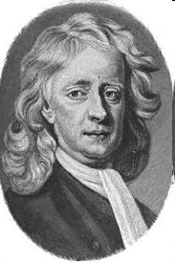
Who Built The House?
“For every house is built by someone, but He who built all things is God” (Hebrews 3:4).
  Is it logical to believe that a house, automobile, television set, watch, etc., was formed by random chance?
  Illustration: Sir Isaac Newton’s (1642-1727) model of the solar system that created itself.

Slide 54
Who Built The House?
“For every house is built by someone, but He who built all things is God” (Hebrews 3:4).
  Is it logical to believe that a house, automobile, television set, watch, etc., was formed by random chance?
  Illustration: Sir Isaac Newton’s (1642-1727) model of the solar system that created itself.
  Which makes more sense: intelligent, purposeful design (Psalm 19:1)? Or, random, blind chance?

Slide 55
Does God Exist?

Slide 56
Does God Exist?
Fact #3—Humans Possess A Unique Nature

Slide 57
Does God Exist?
Fact #3—Humans Possess A Unique Nature
  Is the unique nature of man the result of a random process of evolution?

Slide 58
Does God Exist?
Fact #3—Humans Possess A Unique Nature
  Is the unique nature of man the result of a random process of evolution?
  Or,

Slide 59
Does God Exist?
Fact #3—Humans Possess A Unique Nature
  Is the unique nature of man the result of a random process of evolution?
  Or,
  Is the unique nature of man the result of the divine planning and creation of God?

Slide 60
Is Evolution The Answer?

Slide 61
Is Evolution The Answer?
  Evolution is an unproven theory, or hypothesis.

Slide 62
Is Evolution The Answer?
  Evolution is an unproven theory, or hypothesis.
  Theory- “an explanation based on thought or speculation.”

Slide 63
Is Evolution The Answer?
  Evolution is an unproven theory, or hypothesis.
  Theory- “an explanation based on thought or speculation.”
  Hypothesis- “a proposition assumed as a basis for reasoning” (an “educated guess”).

Slide 64
Is Evolution The Answer?
  Evolution is an unproven theory, or hypothesis.
  Theory- “an explanation based on thought or speculation.”
  Hypothesis- “a proposition assumed as a basis for reasoning” (an “educated guess”).
  Evolution is not a proven fact of science! It is only an assumption without proof!!!!

Slide 65
Is Evolution The Answer?
  Evolution is an unproven theory, or hypothesis.

Slide 66
Is Evolution The Answer?
  Evolution is an unproven theory, or hypothesis.
  Evolution is NOT scientific.

Slide 67
Is Evolution The Answer?
  Evolution is an unproven theory, or hypothesis.
  Evolution is NOT scientific.
    It cannot be observed.

Slide 68
Is Evolution The Answer?
  Evolution is an unproven theory, or hypothesis.
  Evolution is NOT scientific.
    It cannot be observed.
    It cannot be tested.

Slide 69
Is Evolution The Answer?
  Evolution is an unproven theory, or hypothesis.
  Evolution is NOT scientific.
    It cannot be observed.
    It cannot be tested.
    It cannot be repeated.

Slide 70
Is Evolution The Answer?
  Evolution is an unproven theory, or hypothesis.
  Evolution is NOT scientific.
    It cannot be observed.
    It cannot be tested.
    It cannot be repeated.
  Scientists admit that Evolution cannot be proven!

Slide 71
Is Evolution The Answer?
  What do the scientists say?

Slide 72
Is Evolution The Answer?
  What do the scientists say?
  "Throughout the past century there has always existed a significant minority of first-rate biologists who have never been able to bring themselves to accept the validity of Darwinian claims. In fact, the number of biologists who have expressed some degree of disillusionment is practically endless."—Michael Denton, Evolution: A Theory in Crisis (1986), p. 327.

Slide 73
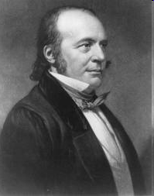
Is Evolution The Answer?
  What do the scientists say?
  “‘The theory [of evolution] is a scientific mistake.’”—Louis Agassiz (1807-1873), quoted in H. Enoch, Evolution or Creation, (1966), p. 139. [Agassiz was a Harvard University professor and the pioneer in glaciation.]

Slide 74
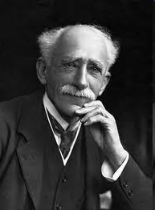
Is Evolution The Answer?
  What do the scientists say?
  “Evolution is baseless and quite incredible.”—John Ambrose Fleming (1849-1945), President, British Association for Advancement of Science, quoted in The Unleashing of Evolutionary Thought.

Slide 75

Is Evolution The Answer?
  What do the scientists say?
  “The Darwinian theory of descent has not a single fact to confirm it in the realm of nature. It is not the result of scientific research, but purely the product of imagination.”—Dr. Albert Fleischmann (1862-1942) [Zoologist, University of Erlangen, Germany].

Slide 76

Is Evolution The Answer?
  What do the scientists say?
  "My attempts to demonstrate evolution by an experiment carried on for more than 40 years have completely failed. At least I should hardly be accused of having started from any preconceived anti-evolutionary standpoint."—Nils Heribert Nilsson (1883-1955) [Swedish geneticist and Professor of Botany at the University of Lund in Sweden] Synthetic Speciation (1953), p. 31.

Slide 77

Is Evolution The Answer?
  What do the scientists say?
  “The absence of fossil evidence for intermediary stages has been a persistent and nagging problem for evolution.” [Dr. Stephen J. Gould, (1941-2002) [Geologist, Paleontoligist, Evolutionary Biologist, Harvard University] Evolution Now, p. 140.

Slide 78
  What Do We Know About Evolution?
“…last year I had a sudden realization—for over 20 years I had thought I was working on evolution in some way. One morning I woke up and something happened in the night, and it struck me that I had been working on this stuff for 20 years and there was not one thing I knew about it. That’s quite a shock to learn that one can be misled so long…so the last few weeks I’ve tried putting a simple question to various people. Question is: can you tell me anything you know about evolution, any one thing, any thing that is true? I tried that question on the geology staff at the Field Museum of Natural History and the only answer I got was silence. I tried it on the members of the Evolutionary Morphology Seminar in the University of Chicago, a very prestigious body of evolutionists, and all I got was silence for a long time, and eventually one person said, ‘I do know one thing—it ought not to be taught in high school.’”
  Dr. Colin Patterson (1933-1998), Senior Paleontologist of the British Museum of Natural History and author of evolutionary texts, speech delivered at American Museum of Natural History, Nov. 5, 1981.

Slide 79
  Three Unanswerable Problems Of The Theory Of Evolution

Slide 80
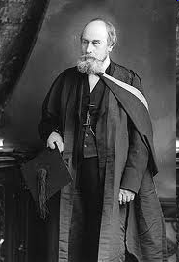
  Three Unanswerable Problems Of The Theory Of Evolution
  * These problems were raised by Canadian geologist Sir J.W. Dawson (Professor of Geology, McGill University) in his 1873 book, The Story of the Earth and Man, and still cannot be answered by evolutionists to this day.

Slide 81
  Three Unanswerable Problems Of The Theory Of Evolution
  1. Life cannot spontaneously originate from organic material.
  * These problems were raised by Canadian geologist Sir J.W. Dawson (Professor of Geology, McGill University) in his 1873 book, The Story of the Earth and Man, and still cannot be answered by evolutionists to this day.

Slide 82
  Three Unanswerable Problems Of The Theory Of Evolution
  1. Life cannot spontaneously originate from organic material.
  2. The gap between animal and vegetable life cannot be bridged.
  * These problems were raised by Canadian geologist Sir J.W. Dawson (Professor of Geology, McGill University) in his 1873 book, The Story of the Earth and Man, and still cannot be answered by evolutionists to this day.

Slide 83
  Three Unanswerable Problems Of The Theory Of Evolution
  1. Life cannot spontaneously originate from organic material.
  2. The gap between animal and vegetable life cannot be bridged.
  3. One kind of plant or animal has never transformed into another kind of plant or animal (See Genesis 1:11-12, 21, 24-25).
  * These problems were raised by Canadian geologist Sir J.W. Dawson (Professor of Geology, McGill University) in his 1873 book, The Story of the Earth and Man, and still cannot be answered by evolutionists to this day.

Slide 84
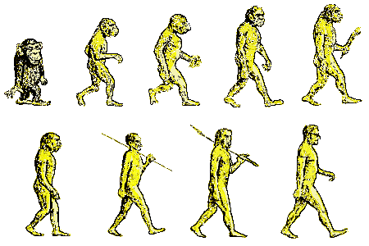
  But What About The Pictures Of Prehistoric Ape-Men In Text Books?

Slide 85
  But What About The Pictures Of Prehistoric Ape-Men In Text Books?
  Is There A “Missing Link?”

Slide 86
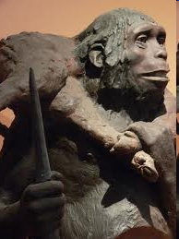
  But What About The Pictures Of Prehistoric Ape-Men In Text Books?
  Is There A “Missing Link?”
  The Heidelberg Man?
  (Discovered in 1907)

Slide 87
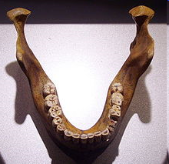
  But What About The Pictures Of Prehistoric Ape-Men In Text Books?
  Is There A “Missing Link?”
  The Heidelberg Man?
  (Discovered in 1907)
One Jaw-Bone!

Slide 88
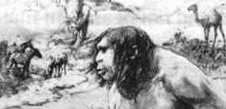
  But What About The Pictures Of Prehistoric Ape-Men In Text Books?
  Is There A “Missing Link?”
  The Nebraska Man?
  (Discovered in 1922)

Slide 89

  But What About The Pictures Of Prehistoric Ape-Men In Text Books?
  Is There A “Missing Link?”
  The Nebraska Man?
  (Discovered in 1922)
One (pig) Tooth!

Slide 90
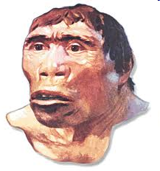
  But What About The Pictures Of Prehistoric Ape-Men In Text Books?
  Is There A “Missing Link?”
  The Java Man?
  (Discovered in 1892)

Slide 91
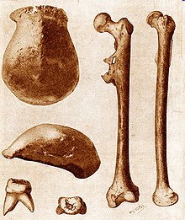
  But What About The Pictures Of Prehistoric Ape-Men In Text Books?
  Is There A “Missing Link?”
  The Java Man?
  (Discovered in 1892)
A Cranial Cap, a Thigh Bone, and a few Teeth…maybe not even from the same creature!

Slide 92
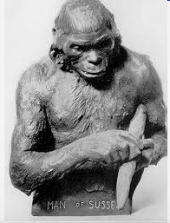
  But What About The Pictures Of Prehistoric Ape-Men In Text Books?
  Is There A “Missing Link?”
  The Piltdown Man?
  (Discovered in 1912)

Slide 93
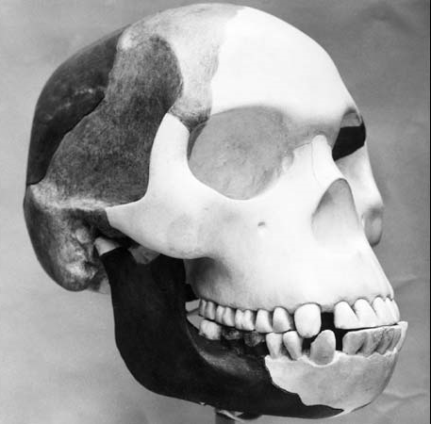
  But What About The Pictures Of Prehistoric Ape-Men In Text Books?
  Is There A “Missing Link?”
  The Piltdown Man?
  (Discovered in 1912)
The greatest find of the 20th century? Proven to be a hoax in 1954!

Slide 94
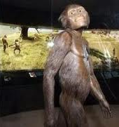
  But What About The Pictures Of Prehistoric Ape-Men In Text Books?
  Is There A “Missing Link?”
  Lucy?
  (Discovered in 1973)

Slide 95
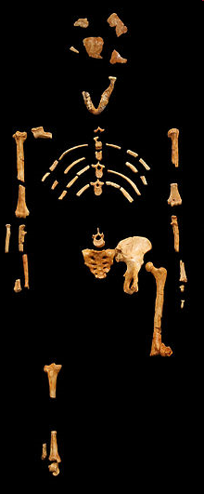
  But What About The Pictures Of Prehistoric Ape-Men In Text Books?
  Is There A “Missing Link?”
  Lucy?
  (Discovered in 1973)
What was actually found?

Slide 96
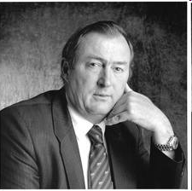
  But What About The Pictures Of Prehistoric Ape-Men In Text Books?
  Is There A “Missing Link?”
  Lucy?
  (Discovered in 1973)
Lucy’s skull is so incomplete that most of it is “imagination made of plaster of paris.” Paleoanthropologist, Dr. Richard Leakey, The Weekend Australian, May 7-8, 1983, Magazine section, p. 3.

Slide 97
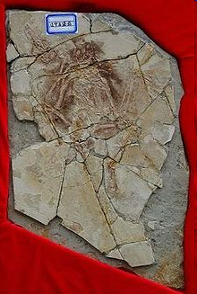
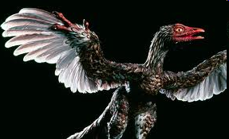
  Missing Link, or Missing Chain?
  The Archaeoraptor?
  (Discovered in 1999)

Slide 98
  Missing Link, or Missing Chain?
  The Archaeoraptor?
  (Discovered in 1999)
National Geographic defrauded the world in October 1999 by presenting the "archaeoraptor," a fossilized bird with a reptile tail. It turned out to be a composite of two different fossils. "National Geographic has reached an all-time low for engaging in sensationalistic, unsubstantiated, tabloid journalism" (Storrs L. Olson, Curator of Birds, National Museum of Natural History, Smithsonian Institution).

Slide 99
  Missing Link, or Missing Chain?

Slide 100
  Missing Link, or Missing Chain?
  Evolutionists would like for us to believe there is just one little missing link in the chain of evidence supporting their theory...

Slide 101
  Missing Link, or Missing Chain?
  Evolutionists would like for us to believe there is just one little missing link in the chain of evidence supporting their theory...
  …But the reality is that there is NO CHAIN of evidence in the first place!

Slide 102
Does God Exist?
Fact #3—Humans Possess A Unique Nature

Slide 103
Does God Exist?
Fact #3—Humans Possess A Unique Nature
  Man has the capacity for rational thought.

Slide 104
Does God Exist?
Fact #3—Humans Possess A Unique Nature
  Man has the capacity for rational thought.
  Man has a sense of morals.

Slide 105
Does God Exist?
Fact #3—Humans Possess A Unique Nature
  Man has the capacity for rational thought.
  Man has a sense of morals.
  Man has an aesthetic appreciation.

Slide 106
Does God Exist?
Fact #3—Humans Possess A Unique Nature
  Man has the capacity for rational thought.
  Man has a sense of morals.
  Man has an aesthetic appreciation.
  Man is inherently religious.

Slide 107
Does God Exist?
Fact #3—Humans Possess A Unique Nature
  Man has the capacity for rational thought.
  Man has a sense of morals.
  Man has an aesthetic appreciation.
  Man is inherently religious.
  Man has a conscience.

Slide 108
Does God Exist?
Fact #3—Humans Possess A Unique Nature
  Man has the capacity for rational thought.
  Man has a sense of morals.
  Man has an aesthetic appreciation.
  Man is inherently religious.
  Man has a conscience.
  Why is man so different from the animals?????

Slide 109
Does God Exist?

Slide 110
Does God Exist?
Fact #4—Man cannot disprove the existence of God

Slide 111
Does God Exist?
Fact #4—Man cannot disprove the existence of God
  “The fool has said in his heart, ‘there is no God’” (Psalm 14:1).

Slide 112
Does God Exist?
Fact #4—Man cannot disprove the existence of God
  “The fool has said in his heart, ‘there is no God’” (Psalm 14:1).
  Why is this a foolish thing to say?

Slide 113
Does God Exist?
Fact #4—Man cannot disprove the existence of God
  “The fool has said in his heart, ‘there is no God’” (Psalm 14:1).
  Why is this a foolish thing to say?
  The one who says it brings himself down to the level of the animals.

Slide 114
Does God Exist?
Fact #4—Man cannot disprove the existence of God
  “The fool has said in his heart, ‘there is no God’” (Psalm 14:1).
  Why is this a foolish thing to say?
  The one who says it brings himself down to the level of the animals.
  2. The one who says it closes his mind to all evidence of God’s existence. (See Romans 1:20-21).

Slide 115
Does God Exist?
Fact #4—Man cannot disprove the existence of God
  “The fool has said in his heart, ‘there is no God’” (Psalm 14:1).
  Why is this a foolish thing to say?
  The one who says it brings himself down to the level of the animals.
  2. The one who says it closes his mind to all evidence of God’s existence. (See Romans 1:20-21).
  The one who says it is unequipped with the knowledge necessary to make such a statement.

Slide 116
Does God Exist?
Fact #4—Man cannot disprove the existence of God
  “The fool has said in his heart, ‘there is no God’” (Psalm 14:1).
  Why is this a foolish thing to say?
  The one who says it brings himself down to the level of the animals.
  2. The one who says it closes his mind to all evidence of God’s existence. (See Romans 1:20-21).
  The one who says it is unequipped with the knowledge necessary to make such a statement.
  The one who says it would have to possess all of the attributes of God in order to know for certain that he is right.

Slide 117
Does God Exist?
What is the most reasonable explanation for:

Slide 118
Does God Exist?
What is the most reasonable explanation for:
The existence of the universe?

Slide 119
Does God Exist?
What is the most reasonable explanation for:
The existence of the universe?
The order, design, and purpose evident in the universe?

Slide 120
Does God Exist?
What is the most reasonable explanation for:
The existence of the universe?
The order, design, and purpose evident in the universe?
The origin of life?

Slide 121
Does God Exist?
What is the most reasonable explanation for:
The existence of the universe?
The order, design, and purpose evident in the universe?
The origin of life?
The unique nature of man?

Slide 123
There Is A God!!!!

