Slide 2
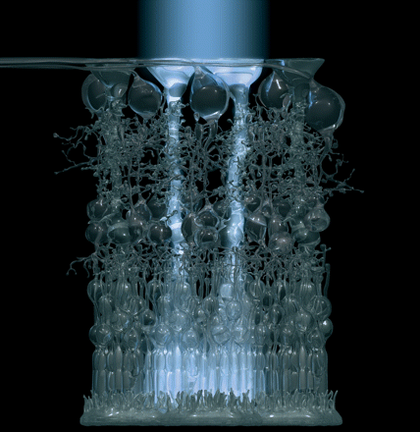
The Poor Design Argument
“Junk” DNA

Slide 3
The Bible
The Book on which Christianity is founded proclaims:
Psalms 19:1-4 – the heavens declare the glory of God
Rom. 1:20 - His invisible attributes … understood by the things that are made
  His Eternal Power
  His Divine Nature (Godhead)
  Observation of Nature reveals God (Science)
Argument from Design

Slide 4
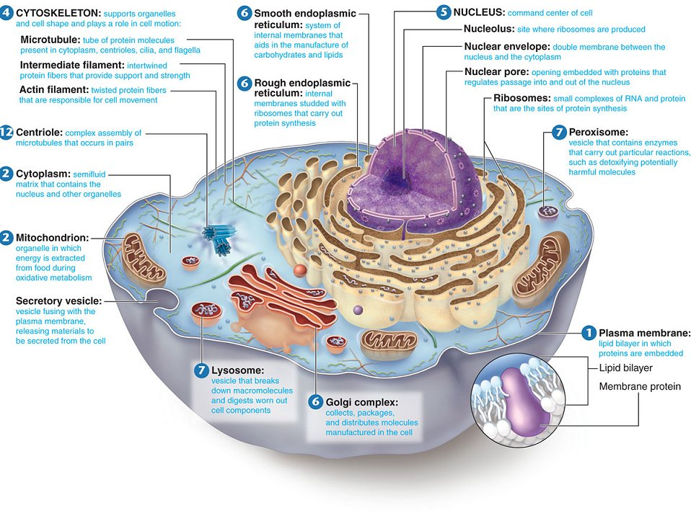
The Cell:
A self-replicating nanoscale robot

Slide 5
Signature in the Cell
Every living cell is full of signs of intelligent design.
In 1953 Crick and Watson discovered the structure of DNA.

Slide 6
DNA
Double helix with cross bars
Thymine, Cytosine,
Adenine, Guanine
Capacity to reproduce itself
acdskc
Notes:
46

Slide 7
Signature in the Cell
Every living cell is full of signs of intelligent design.
In 1953 Crick and Watson discovered the structure of DNA.
Over the next decade, scientists found that DNA contained a language which they learned to decode and read!
A code for building proteins and other parts of the living cell.

Slide 8
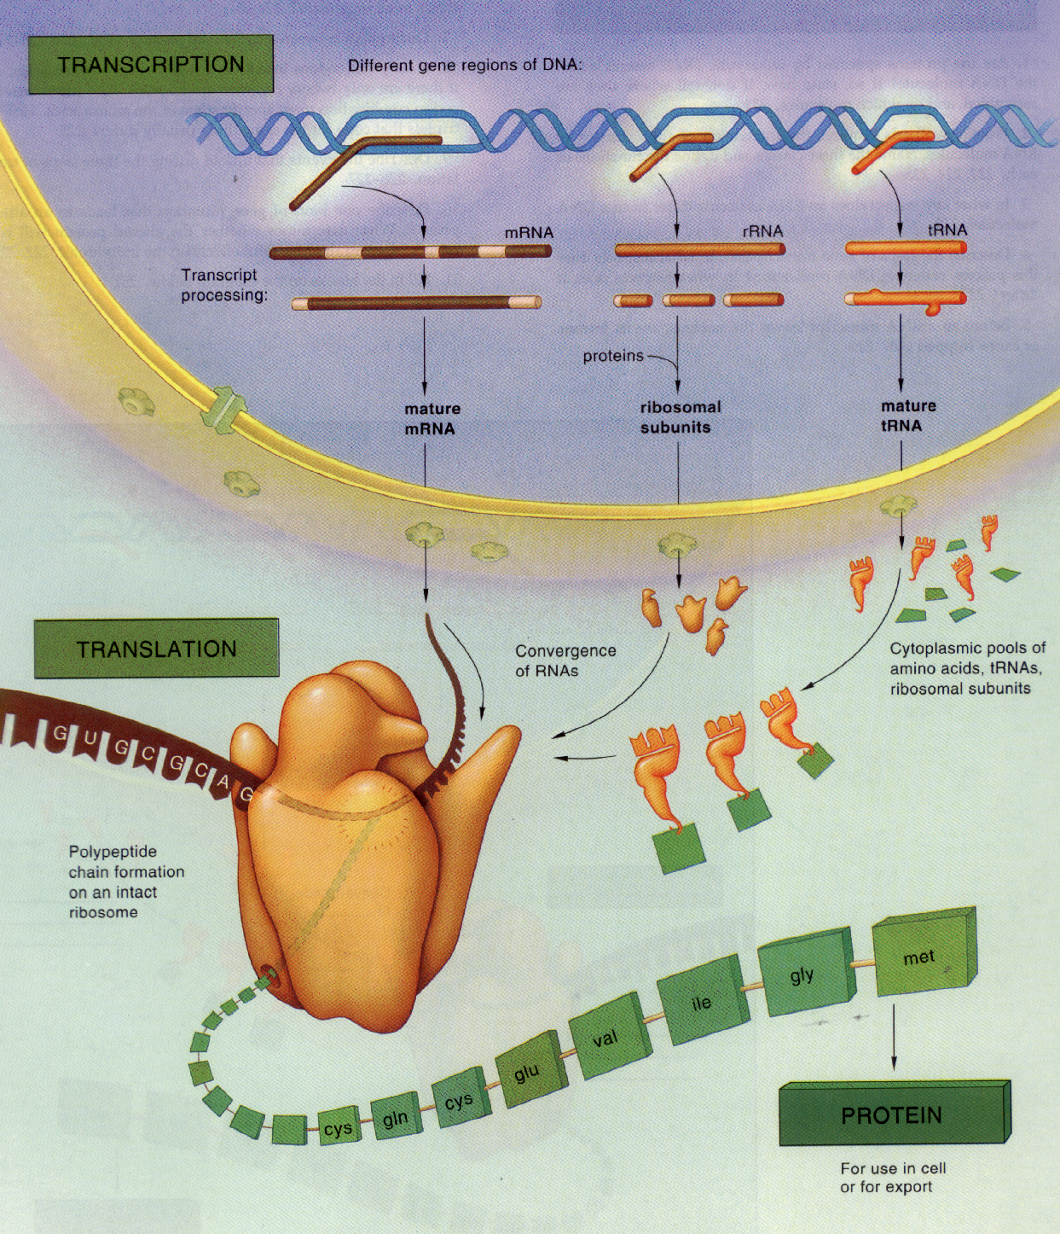
Transcription,
Migration,
& Translation for Protein Building

Slide 9
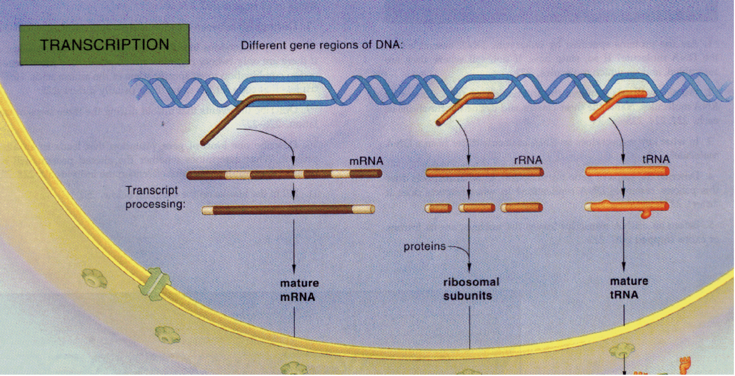

Slide 10
Signature in the Cell
As the process for building proteins and other molecules became better understood from the 1970’s through the 1990’s, it also was discovered that parts of the DNA were not used in that process.
In fact, it became clear that probably less than 5% of the DNA was needed for that process.
What about the rest of the DNA?!

Slide 11
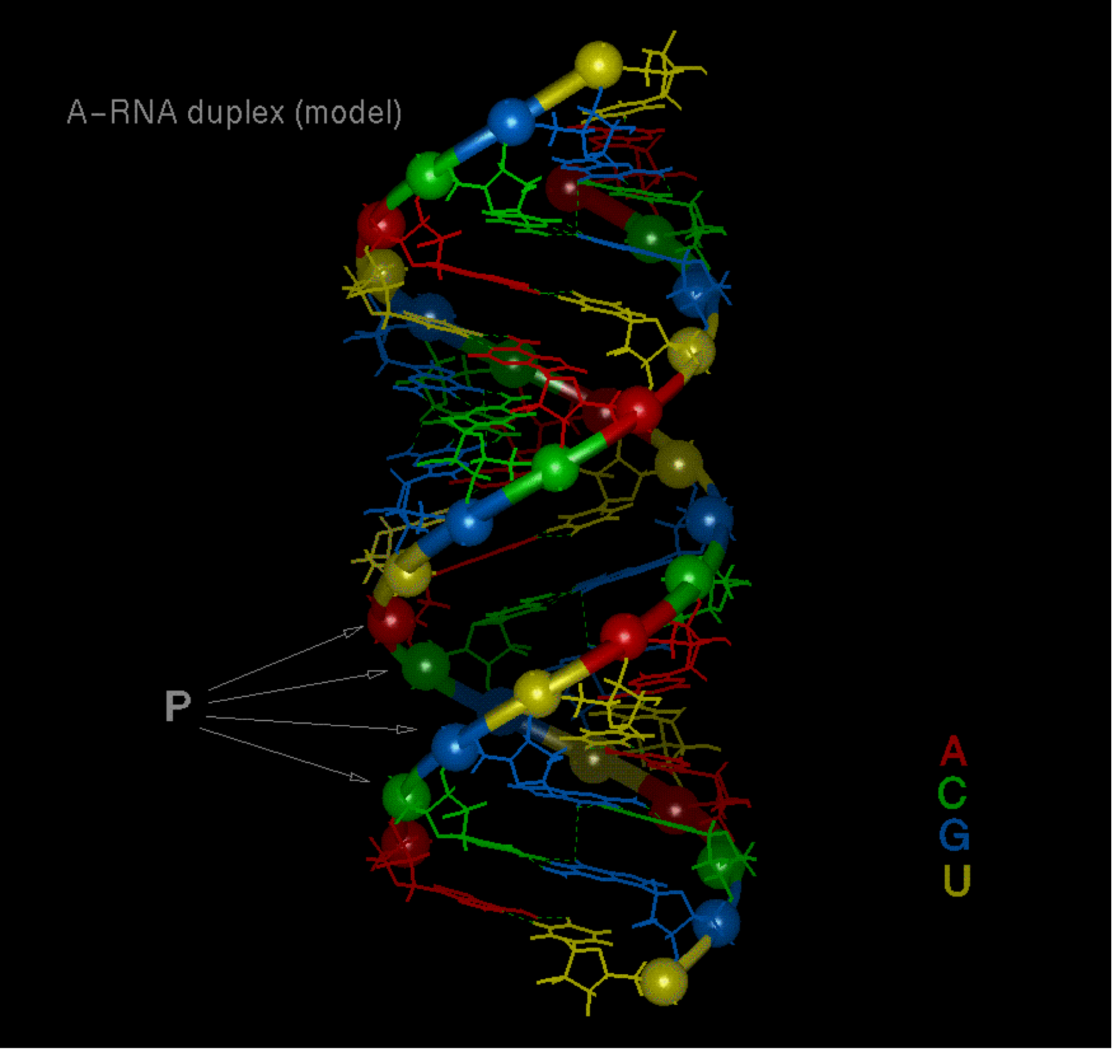
DNA
Some began to describe the remaining parts of the DNA as “junk.”

Slide 12
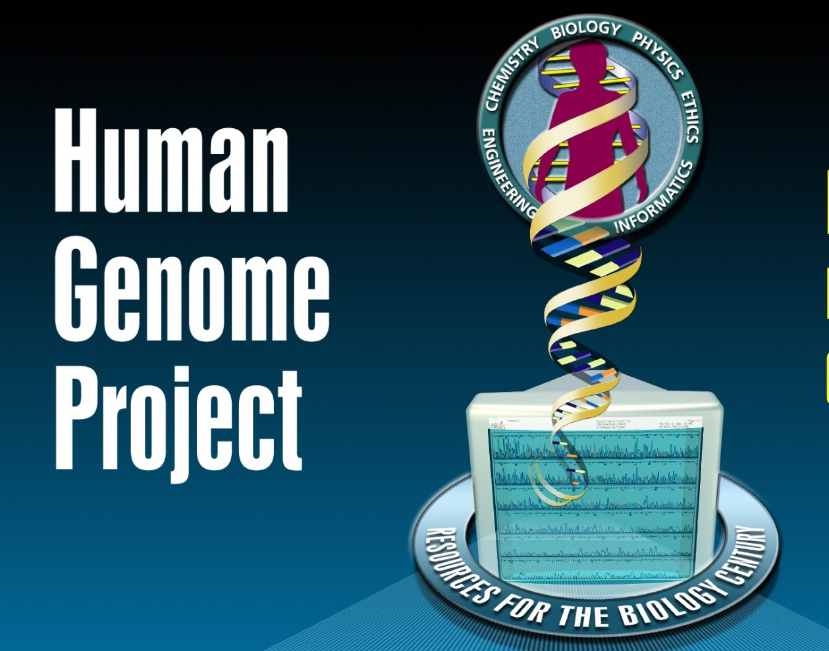
1990 - 2003

Slide 13
DNA
Kenneth Miller in “Life’s Grand Design,” Technology Review 97 (Feb.-March 1994)
“The human genome is littered with pseudogenes, gene fragments, ‘orphaned genes,’ ‘junk’ DNA, and so many repeated copies of pointless DNA sequences that it cannot be attributed to anything that resembles intelligent design.”

Slide 14
DNA
Richard Dawkins in The Greatest Show on Earth: Evidence for Evolution, 2009, p. 332
“It is a remarkable fact that the greater part (95% in the case of humans) of the genome might as well not be there, for all the difference it makes.”

Slide 15
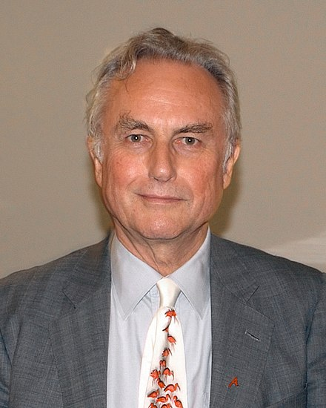
Richard Dawkins
The Greatest Show on Earth: The Evidence for Evolution
2009
“Pseudogenes are genes that once did something useful but have now been sidelined and are never transcribed or translated … What pseudogenes are useful for is embarrassing creationists. It stretches even their creative ingenuity to make up a convincing reason why an intelligent designer should have created a pseudogene … unless he was deliberately setting out to fool us. (pg. 322-323)

Slide 16

ENCyclopedia Of DNA Elements
To identify all the functional elements of the human genome
2003 - 2012

Slide 17
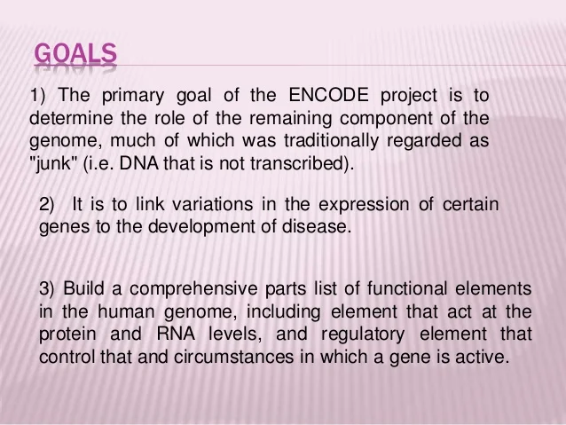
ENCODE Project Goals

Slide 18

ENCODE Results About the Supposed
"Junk" DNA
Over 80% of the human genome is actively involved in at least one or more biochemical reactions associated with gene regulation in at least one type of cell.
“ENCODE Explained,” Nature, 489, pg. 533-55

Slide 19
ENCODE Results About the Supposed
"Junk" DNA
The human genome may contain only about 21,000 genes, but the ENCODE scientists found 70,292 areas called gene promoters that precede the protein-coding areas of genes.
”Junk DNA Myth Continues Its Demise,”
Acts and Facts, October 31, 2012

Slide 20
ENCODE Results About the Supposed
"Junk" DNA
Gene expression is controlled by a broad array of:
Regulatory proteins
Chemical marks in the DNA (epigenetic factors)
Gene promoter features (specific DNA sites)
Enhancer sequencers sometimes located millions of bases from a gene or set of genes
“ENCODE Explained,” Nature, 489, pg. 533-55

Slide 21
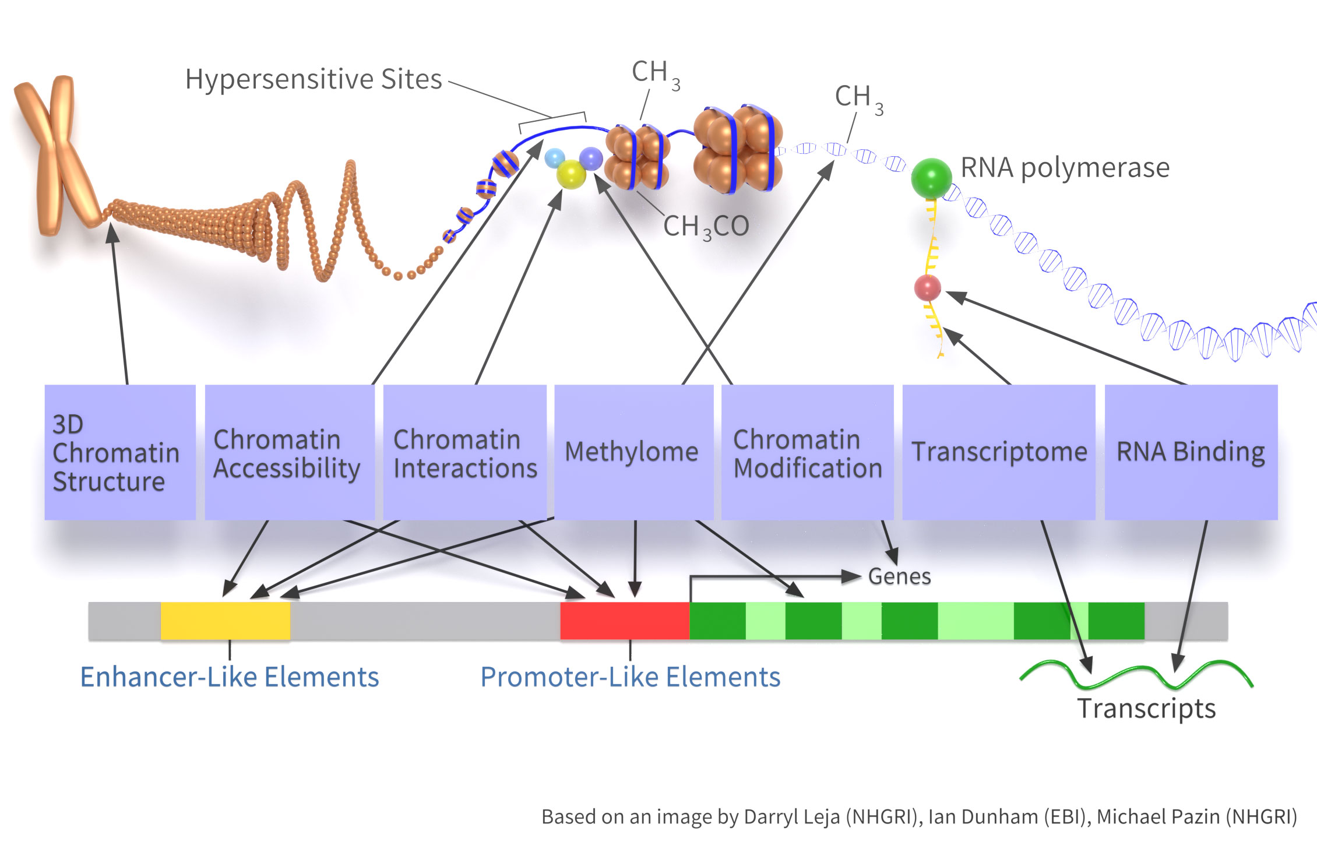
ENCODE Project Results

Slide 22
Recent Discoveries About the Supposed "Junk" DNA
Evidence for specific biological functions of non-protein-coding DNA
  Pseudogenes
    Some have produced functional proteins
    Some produce RNA’s that suppress the expression of their corresponding functional genes.
    Some produce RNAs that increase the expression of their corresponding functional genes
The Myth of Junk DNA by Dr. J. Wells, 2011

Slide 24
Recent Discoveries About the Supposed “Junk DNA”
Evidence for specific biological functions of non-protein-coding DNA
  Introns have functions
    Rich in splicing-factor recognition sites
    Encode a majority of the small RNA’s
    RNA’s from introns influence gene expression by modifying chromatin
The Myth of Junk DNA by Dr. J. Wells, 2011

Slide 25
Recent Discoveries About the Cell’s Informational System
Densely concentrated, specified information in DNA
  Multiple messages stored in the same sequence of bases
  “Spliceosomes” and “editosomes”
Signature in the Cell by Dr. S. Meyer, 2009
Darwin Devolves by M.J. Behe, 2019

Slide 26
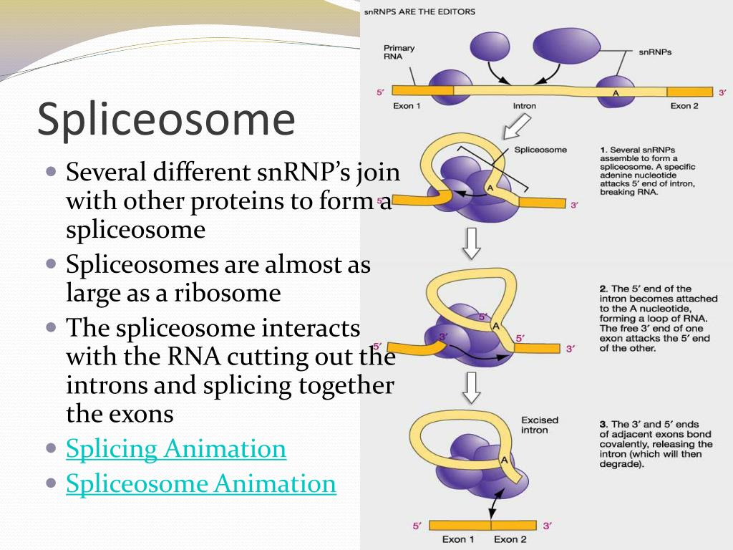
ENCODE Project Results

Slide 27
Recent Discoveries About the Cell’s Informational System
Densely concentrated, specified information in DNA
  Multiple messages stored in the same sequence of bases
  “Spliceosomes” and “editosomes”
  Code within a code
  Dual and overlapping messages
Signature in the Cell by Dr. S. Meyer, 2009
Darwin Devolves by M.J. Behe, 2019

Slide 28
DNA
The more we learn about supposed “junk” DNA, the more it appears to be designed!

Slide 29
Intelligent Design or Natural Causes
Which is more reasonable?
“Everywhere we look, from the macroscopic to the microscopic things look like they are MADE”
“A loud, clear, piercing cry of DESIGN!!”
Darwin’s Black Box by Dr. M. Behe, 2006

