Slide 1


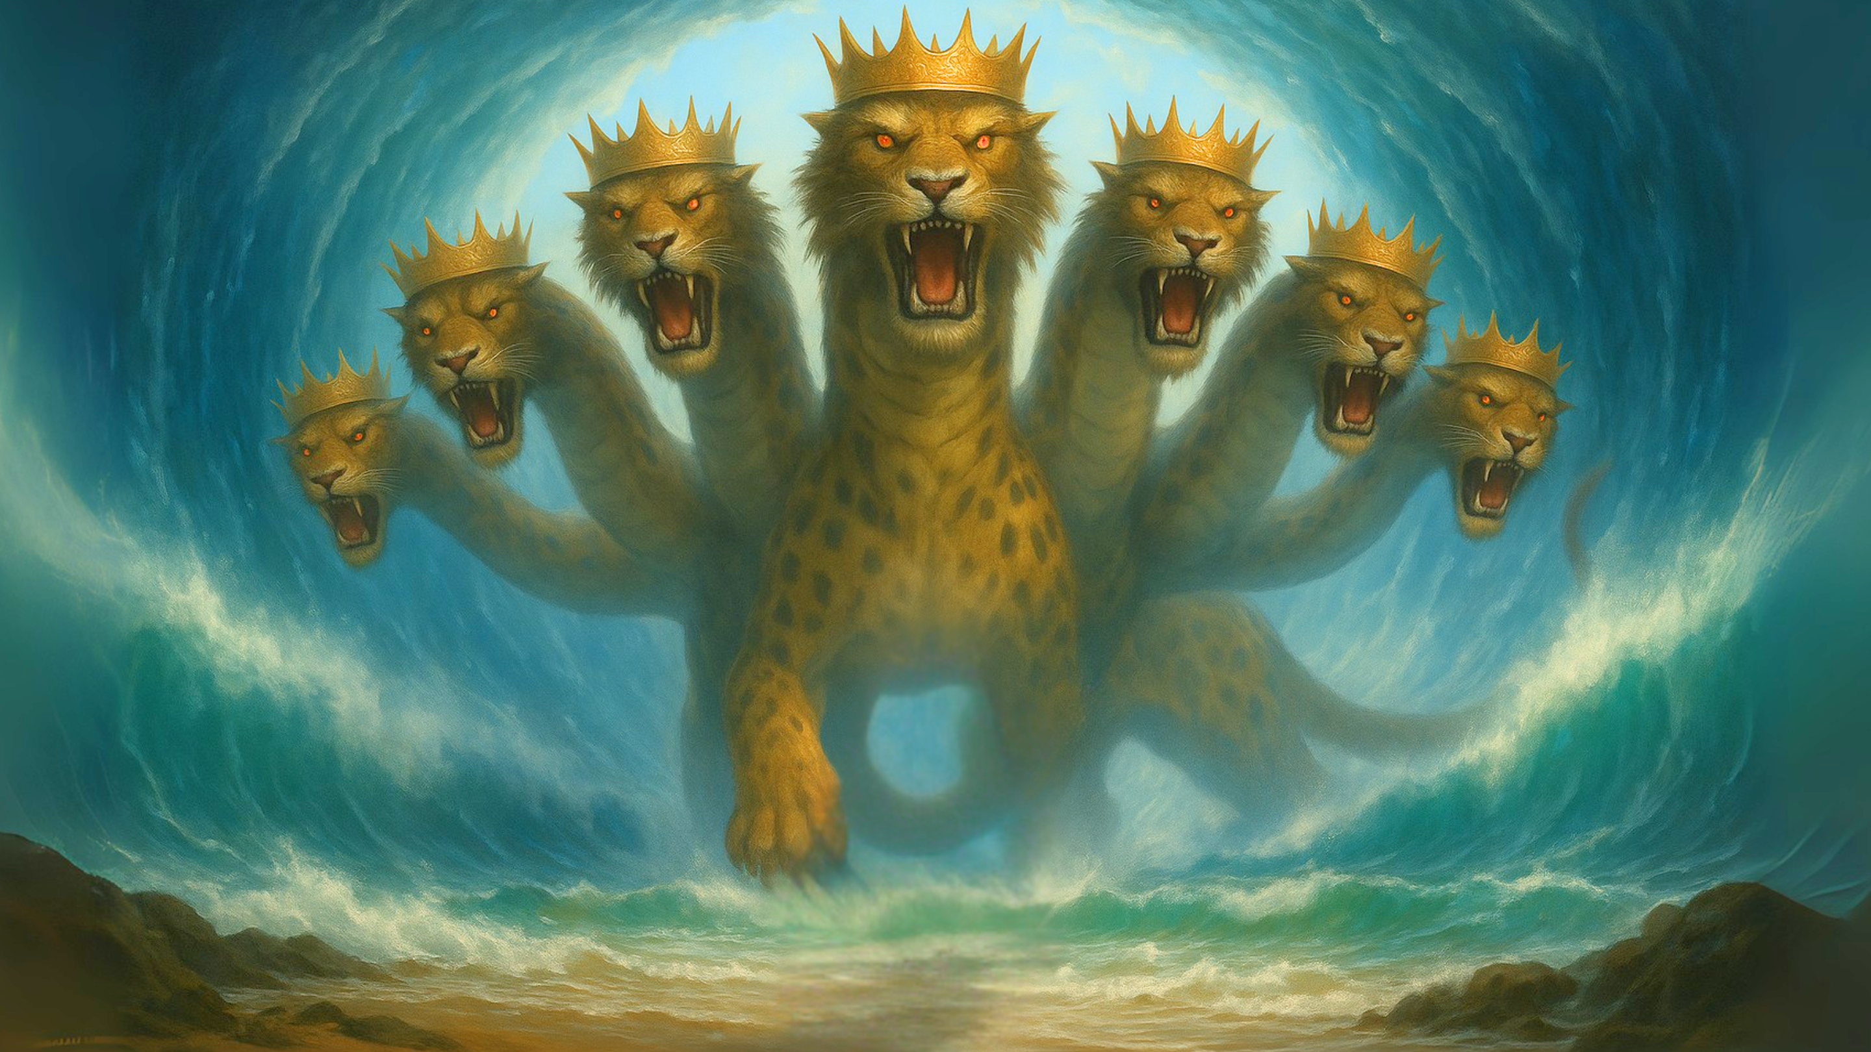

Slide 3
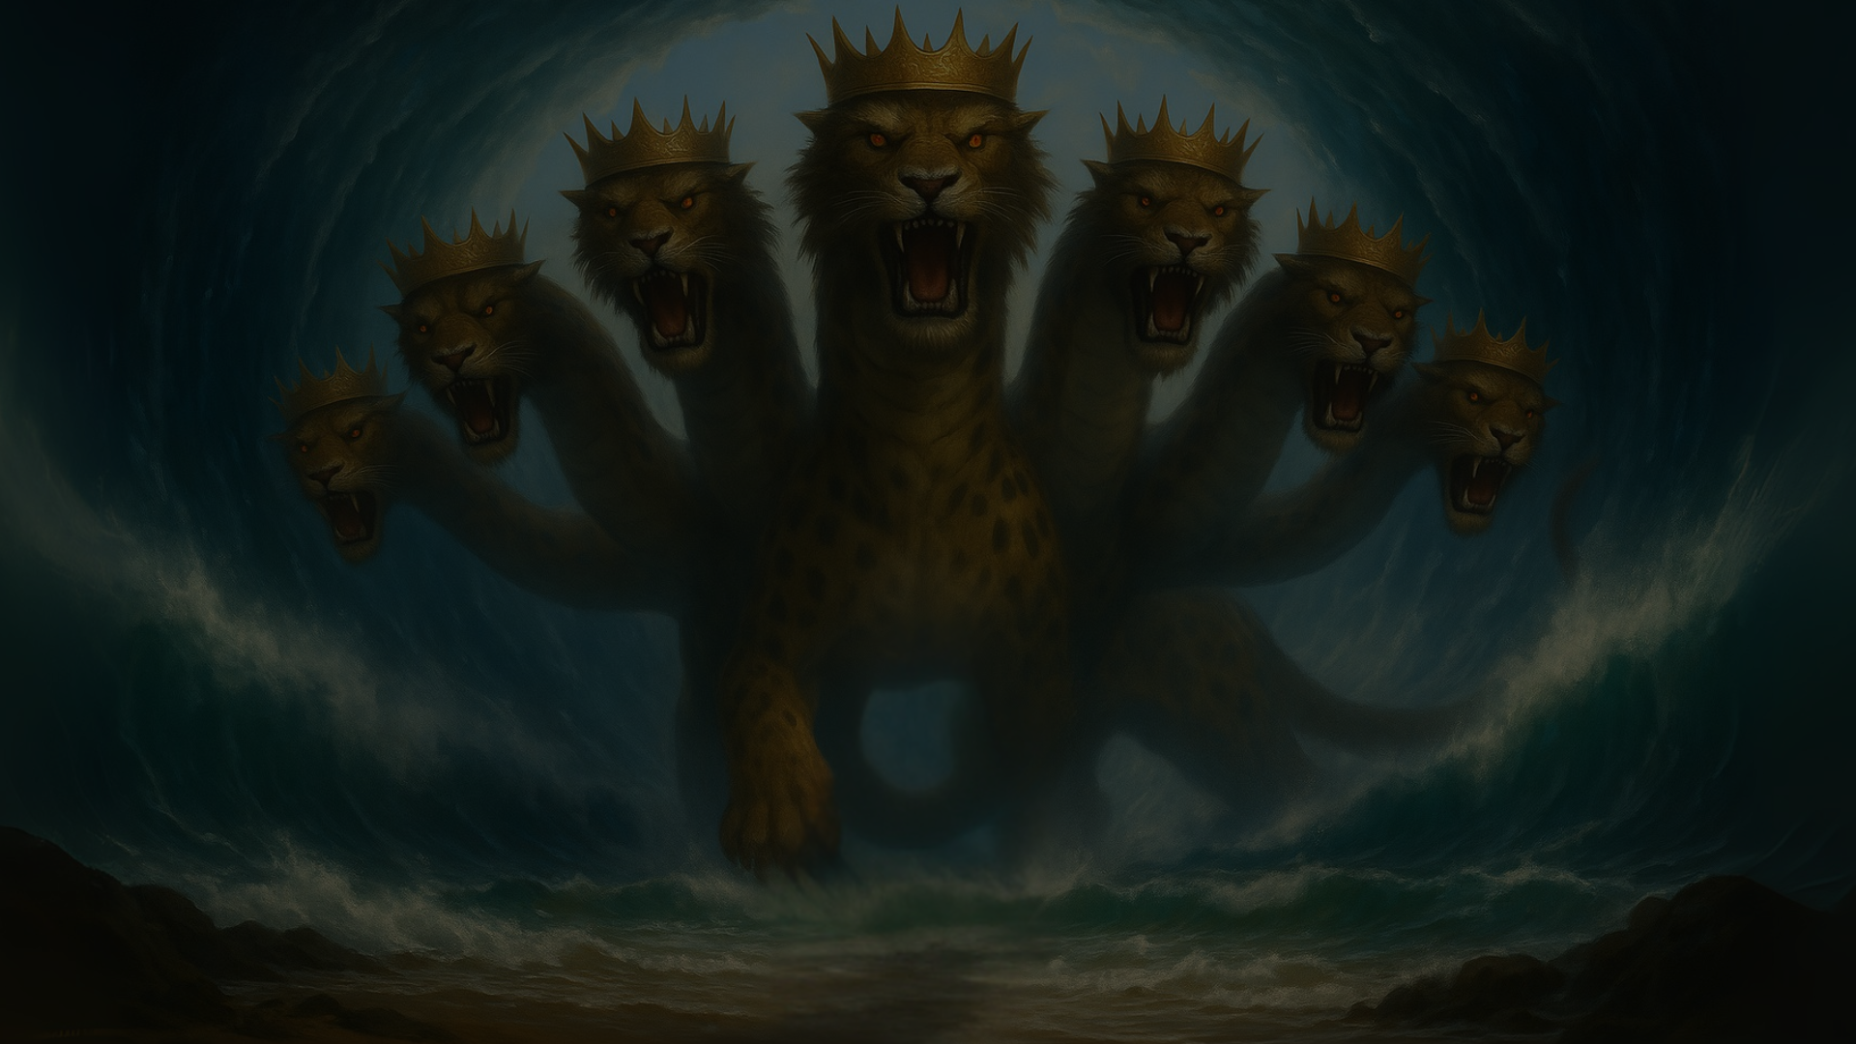
Defending A Roman-Centric Interpretation

Slide 4
The Audience
The Historical Context
  Persecution of the Christians
  “All who dwell on the earth”

Slide 5
The Beasts & Babylon
Sea Beast = Rome
  Rises from the sea (13:1)
  Blasphemous names (13:1)
  Authority over all nations (13:7)
Earth Beast = Jerusalem & Jewish Leadership
  Exercises the Authority of the First Beast (13:12)
  Makes the earth and all its inhabitants worship the first beast (13:12)
  Deceives the entire earth (13:14)
  No one can buy or sell without the mark (13:14)

Slide 6
The Beasts & Babylon
Babylon the Harlot = Jerusalem
  “ruling over the kings of the earth” (17:18)

Slide 7
The Degree of Persecution
  Rev 1:7 – “all tribes of the earth”
  Rev 7:9 – “every nation, from all tribes and peoples and languages”
  Rev 11:9-10 – “the peoples and tribes and languages and nations…those who dwell on the earth will rejoice…”
  Rev 13:7-8 – “over every tribe and people and language and nation, and all who dwell on earth will worship”
  Rev 14:6 - ”those who dwell on earth, to every nation and tribe and language and people”
  Rev 16:14 – “to the kings of the whole world”
  Rev 17:15 – “peoples and multitudes and nations and languages”
  Rev 18:3 –”All nations…kings of earth…merchants of earth.”
  Rev 18:23 “all nations were deceived”

Slide 8
The Reach of the Harlot
  Rev 17:1-2 – “seated on many waters, with whom the kings of earth have commited…”
  Rev 17:5 - “the prostitute of earth’s abominations”
  Rev 17:8 – “the dwellers of the earth…marvel”
  Rev 17:15 – “the waters are…peoples and multitudes and nations and languages”
  Rev 17:18 – “the woman…is the great city that has dominion over the kings of the earth”
  Rev 18:3 – ”for all nations have drunk…of her sexual immorality…the kings of earth have committed immorality with her…the merchants of earth have grown rich from…her…living”
  Rev 18:4 – ”come out of her…let you take part in her sins, lest you share in her plagues”
  Rev 18:11 – “the kings of earth weep…for her”
  Rev 18:12 – “the merchants of earth weep…for her”
  Rev 18:15 – “The merchants…stand far off”
  Rev 18:17 – “all shipmasters and seafaring men…”
  Rev 18:19 – “the great city where all who had ships at sea grew rich…”
  Rev 18:23 – “all nations were deceived by your sorcery”

Slide 9
The Beasts & Babylon
Babylon the Harlot = Jerusalem
  “ruling over the kings of the earth” (17:18)
  Early Church writings
  Destruction of Babylon in Chapter 18

Slide 10
The Destruction of the Harlot
  No longer a center of life or power (18:2)
  Political leaders will mourn their loss (18:9)
  Fear and astonishment spread rapidly. (18:10)
  Economic collapse (18:11)
  End of excess, consumerism, and material wealth (18:12-13)
  Babylon’s pleasure and desires vanish (18:14)
  Wealthy merchants are devastated (18:15-17)
  The global shipping/trade industry feels collapse (18:17-19)
  The earth mourns and heaven rejoices (18:20)
  Global decision was brought to an end (18:23)
  Babylon is a murderer of God’s people (18:24)

Slide 11
The Relevance of a Roman Centric View
Revelation’s Warning Apply to Future Generations
Future Governments should be cautious
No empire will last forever
The Enemies of God’s people will always be destroyed

