Slide 1
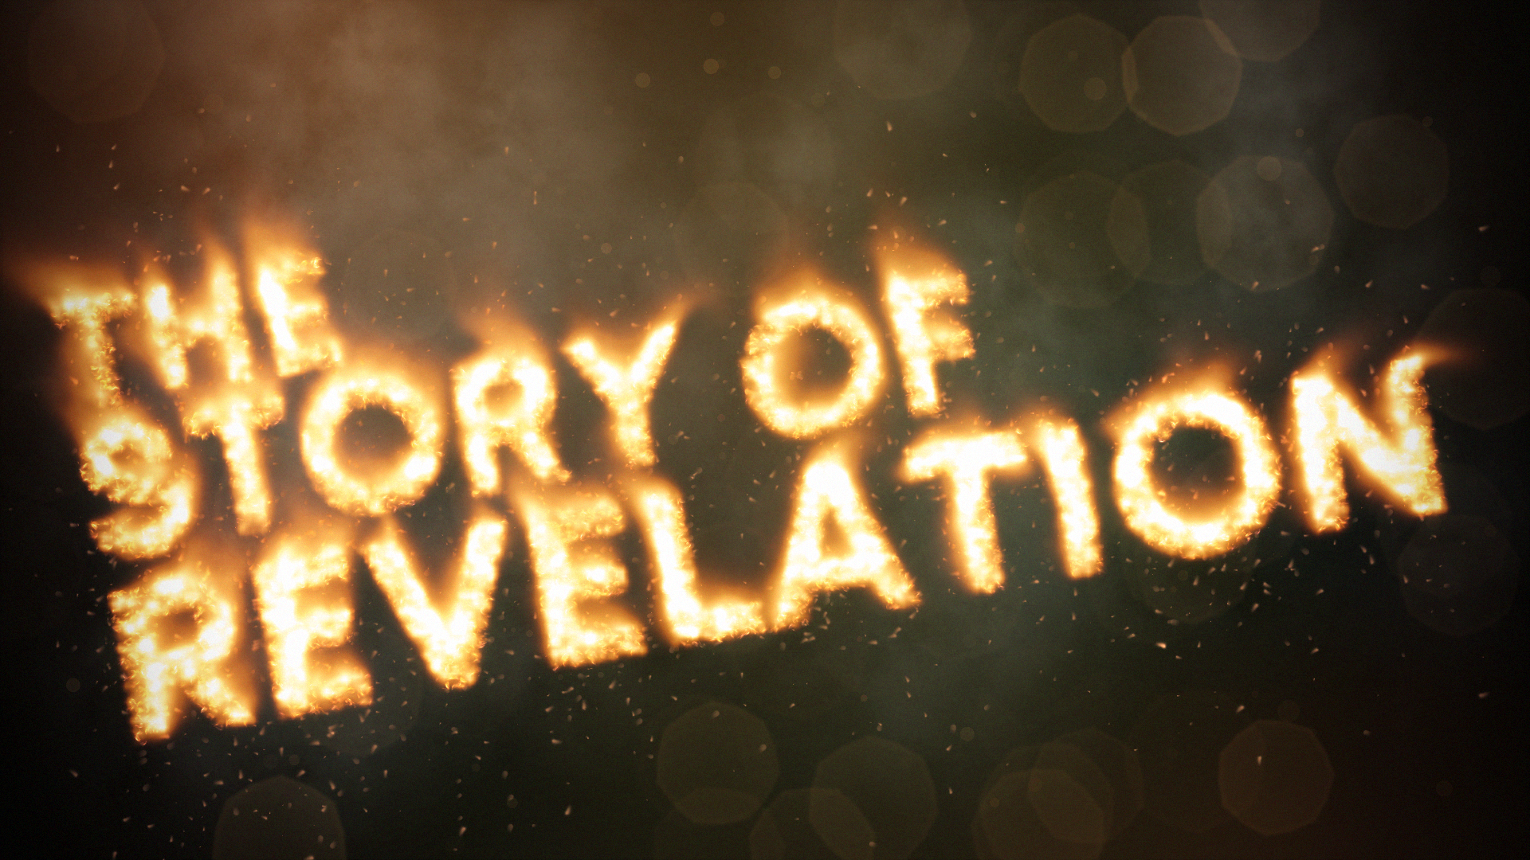

Slide 2
The White Horse & It’s Rider
Revelation 19:11-21
Vs. 11-18 – Expanding detail of the rider
Vs. 19-21 – the beasts wage war with the rider

Slide 3
Review
Allies
  God
  The Lamb – Jesus
  The Suffering Saints
Enemies
  Sea Beast
  Earth Beast
  The Harlot
  The Dragon

Slide 4
The Fate of the Dragon
Chapter 20
Vs. 1-3 – Satan is Defeated!
Vs. 4-6 – Saints are Victorious!
Vs. 4-10 – Satan Makes a Comeback!
Vs. 11-15 – Then Comes the Judgment!

Slide 5
The Fate of the Saints
Chapter 21-22:5
What does John See?
  New Heaven & Earth
  New Jerusalem, the holy city

Slide 6
The New Jerusalem
Chapter 21-22:5
  Brilliance
  Walls; Gates
  Foundations
  Size
  God & the Lamb are its temple and source of light
  Nations walk by its light; kings bring their glory into it
  No night
  Gates never closed
  No wicked enter
  River of the water of life flows from the throne of God
  Beside the river, the tree of life bears fruit all year long
  No more curse

Slide 7
The Fate of the Saints
Chapter 21-22:5
What does John Hear?
  God is among his people in a perfect paradise
  God guarantees these things and announces who can be a part of it

Slide 8
The Image of Heaven
& It’s Symbolism
Perfect Fellowship (21:3)
Perfect Happiness (21:4)
Perfect Security (21:15-16; 25)
Perfect Provision (22:2)

Slide 9
The Book’s Close
Chapter 21-22:5
Vs.6 – This will happen!
Vs. 6-7, 10, 12, 20 – “Soon” statements
Vs. 11-13 – God’s justice
Vs. 14-15 – Pronouncement of blessing
Vs. 16 – Reminder of the audience
Vs. 18-19 – A word of warning

