Slide 1
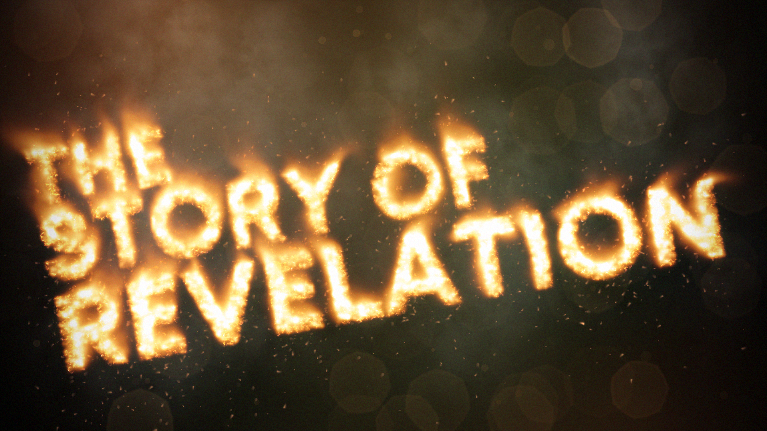

Slide 2
The 7th Seal
Chapter 8:1-5
Silence in Heaven – 8:1
Seven angels are given the trumpets – 8:2
Prayers of the saints go up to God - 8:3-4
The fire from the alter is cast to the earth – 8:5

Slide 3
The 7 Trumpets
Chapter 8-9
Hail, Fire and Blood – 1/3 of earth is burned
1/3 of sea became blood; 1/3 of creatures died, 1/3 of ships were destroyed
1/3 of water becomes wormwood
1/3 of Sun, moon, stars were struck and didn’t shine – darkness
A pit opens – Out comes smoke and locust - Torment
Angels of the Euphrates are released – 1/3 of men are killed

Slide 4
The 7 Trumpets
Chapter 8-9
Hail, Fire and Blood – 1/3 of earth is burned
1/3 of sea became blood; 1/3 of creatures died, 1/3 of ships were destroyed
1/3 of water becomes wormwood
1/3 of Sun, moon, stars were struck and didn’t shine – darkness
A pit opens – Out comes smoke and locust - Torment
Angels of the Euphrates are released – 1/3 of men are killed

Slide 5
The 7 Trumpets
Chapter 8-9
Hail, Fire and Blood – 1/3 of earth is burned
1/3 of sea became blood; 1/3 of creatures died, 1/3 of ships were destroyed
1/3 of water becomes wormwood
1/3 of Sun, moon, stars were struck and didn’t shine – darkness
A pit opens – Out comes smoke and locust - Torment
Angels of the Euphrates are released – 1/3 of men are killed

Slide 6
The Seven Thunders
Chapter 10
Vs. 1-3 – An angel carries a book.
  Seven thunders sound when he cries out
Vs. 4 – John is told not to write it down
Vs. 5-7 – “There will be no more delay”
Vs. 8-10 – John is told to eat the book
  It will be sweet in his mouth; bitter in his stomach
Vs. 11 – John must prophesy about nations, kings, etc.

Slide 7
The Two Witnesses
Chapter 11
The Main Characters
The Two Witnesses
The Beast out of the Abyss
The Earth-dwellers

Slide 8
The Two Witnesses
Chapter 11
The Action
Vs. 1-2 - The temple of God is measured.
Vs. 3-6 - Two witnesses prophesy for 1260 days. They prevent enemies from harming them.
Vs. 7 - The beast from the abyss wages war with them and kills them.
Vs. 8-10 - Many indignities are inflicted earth-dwellers celebrate their deaths.
Vs. 11-12 - God breathes life into them, they stand and are caught up into heaven.
Vs. 13 – A great earthquake destroys 1/10 of the city and kills 7,000.

Slide 9
The Two Witnesses
Chapter 11
The Measuring of the Temple (vs. 1-2)
The Two Witnesses (vs. 3-13)
The Battle With The Beast (3:7-10)
The Hope (vs. 11-13)

Slide 10
The Mark of the Saints
Chapter 14
Vs 1-5
  A further description of the 144K
    Only they can learn the new song of worship in Heaven
    These have not defiled themselves
    They follow the lamb wherever he goes
    They are blameless

Slide 11
The Marks of Revelation
Chapter 14
Vs. 6-13
  Three Angels and their message:
    God’s judgement is coming. Worship Him
    Immorality will fall
    The Mark of the Beast vs the Mark of the Saints

Slide 12
The Marks of Revelation
Chapter 14
Vs. 14-20
  The Earth is prepared for the coming judgement
    Christians are taken up and protected
    The wine of God’s wrath is being prepared (vs. 10)
    The winepress of God’s wrath is prepared
    Blood flows from this winepress
      As high as the horses bridle
      For 1600 Stadia (200 miles)

Slide 13
In Review
Chapter 1 – The vision of Jesus & the book’s purpose.
Chapter 2-3 – Jesus & his relationship with the audience.
Chapter 4 – God is on his throne.
Chapter 5 – Jesus (the lamb) will open the scroll.
Chapter 6 – The Seals & The coming judgement.
Chapter 7 –”Who Shall Stand?”
Chapter 8-9 – The trumpets call or repentance. Judgement is delayed.
Chapter 10 – No more delay.
Chapter 11 – God’s people are down, but they’re not out. / 7th Seal
Chapter 12-13 – The target of the coming judgement.
Chapter 14 – Judgement is being prepared and is coming soon.

